Slide 1
Econ 645: Week 8
Limited Dependent Variables Part 1
Review of Logit and Probit Estimators
Tobit Estimator

Slide 2
Overview
Limited Dependent Variables
Maximum Likelihood Estimator
Binary Dependent Variables
Logit
Probit
Nominal (or Categorical) dependent variables
Multinominal Logit
Nonnegative Dependent Variables
Tobit – Corner Solution Response
Stata

Slide 3
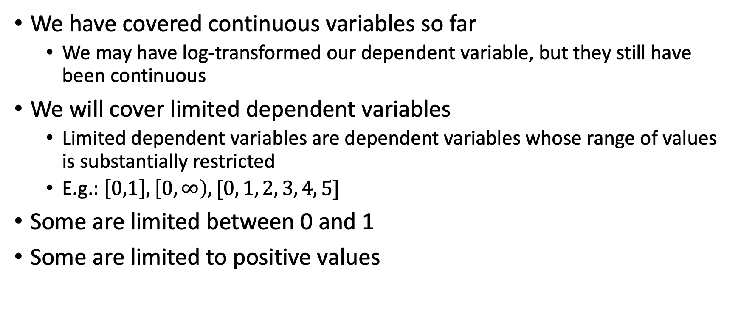
Limited Dependent Variables
We have covered continuous variables so far
We may have log-transformed our dependent variable, but they still have been continuous
We will cover limited dependent variables
Limited dependent variables are dependent variables whose range of values is substantially restricted
E.g.: $\left[0,1\right], \left[0,∞\right), [0, 1, 2, 3, 4, 5]$
Some are limited between 0 and 1
Some are limited to positive values

Slide 4
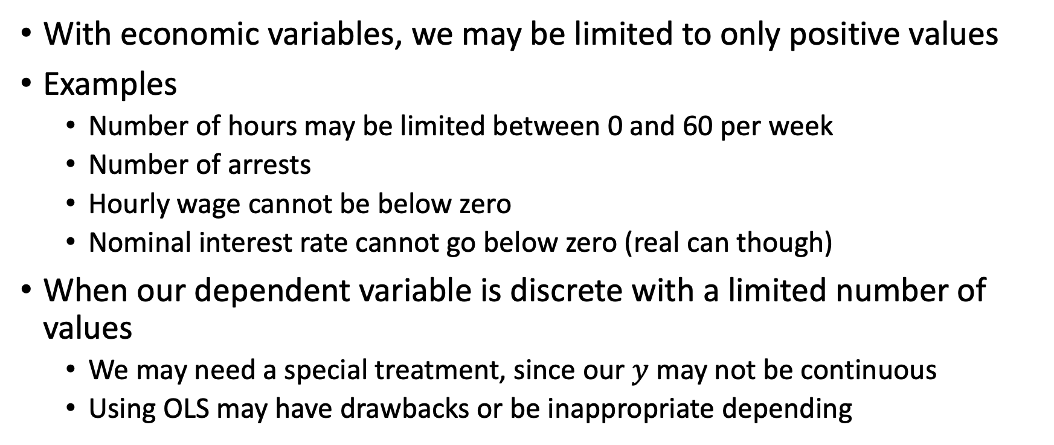
Limited Dependent Variables
With economic variables, we may be limited to only positive values
Examples
Number of hours may be limited between 0 and 60 per week
Number of arrests
Hourly wage cannot be below zero
Nominal interest rate cannot go below zero (real can though)
When our dependent variable is discrete with a limited number of values
We may need a special treatment, since our $y$ may not be continuous
Using OLS may have drawbacks or be inappropriate depending

Slide 5
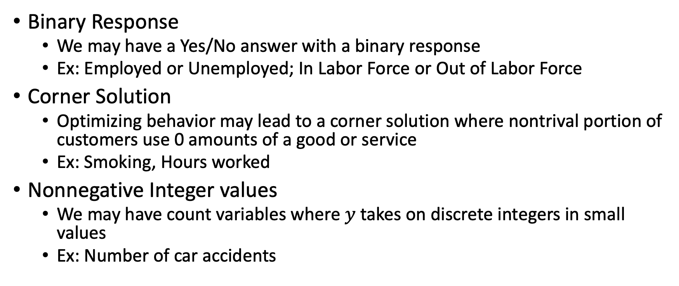
Limited Dependent Variables
Binary Response
We may have a Yes/No answer with a binary response
Ex: Employed or Unemployed; In Labor Force or Out of Labor Force
Corner Solution
Optimizing behavior may lead to a corner solution where nontrival portion of customers use 0 amounts of a good or service
Ex: Smoking, Hours worked
Nonnegative Integer values
We may have count variables where $y$ takes on discrete integers in small values
Ex: Number of car accidents

Slide 6
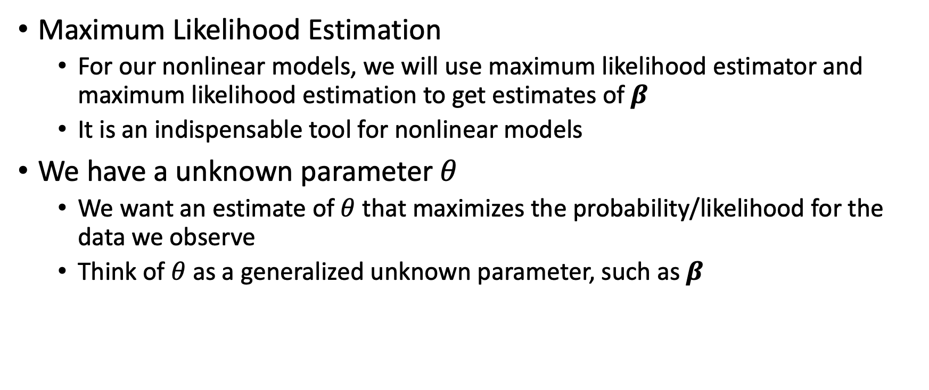
Maximum Likelihood Estimator
Maximum Likelihood Estimation
For our nonlinear models, we will use maximum likelihood estimator and maximum likelihood estimation to get estimates of $β$
It is an indispensable tool for nonlinear models
We have a unknown parameter $θ$
We want an estimate of $θ$ that maximizes the probability/likelihood for the data we observe
Think of $θ$ as a generalized unknown parameter, such as$β$

Slide 7
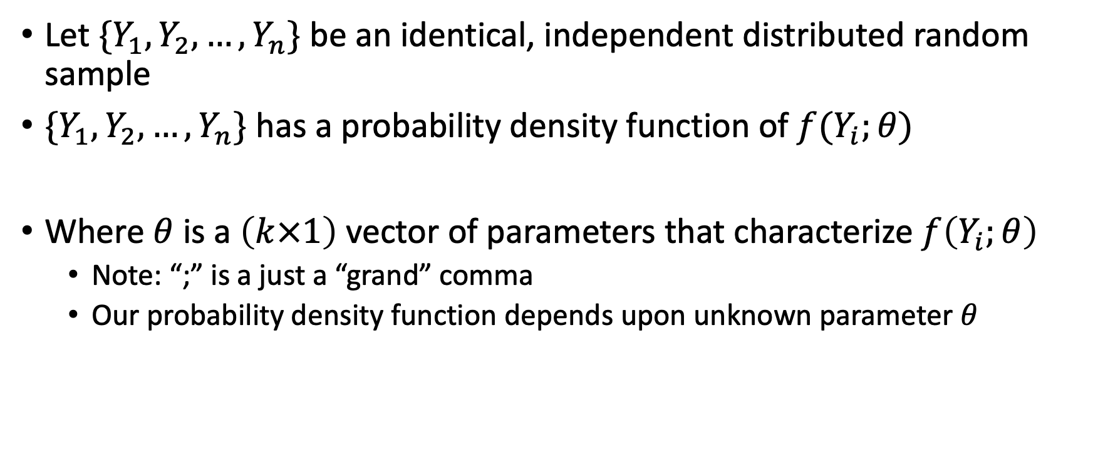
Maximum Likelihood Estimator
Let $\{Y_{1},Y_{2},…,Y_{n}\}$ be an identical, independent distributed random sample
$\{Y_{1},Y_{2},…, Y_{n}\}$ has a probability density function of $f(Y_{i};θ)$
Where $θ$ is a $\left(k×1\right)$ vector of parameters that characterize $f\left(Y_{i};θ\right)$
Note: “;” is a just a “grand” comma
Our probability density function depends upon unknown parameter $θ$

Slide 8
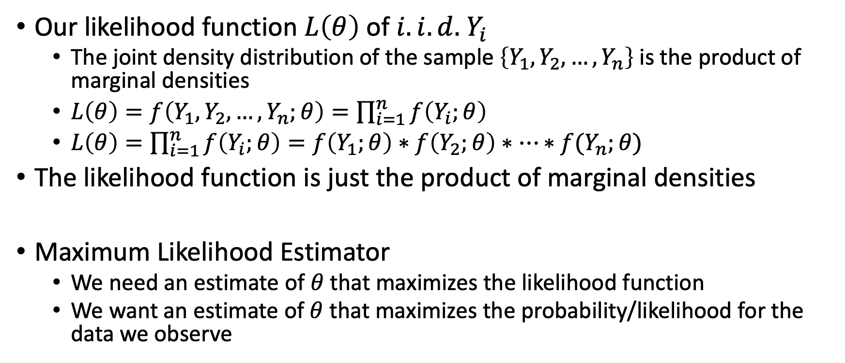
Maximum Likelihood Estimator
Our likelihood function $L\left(θ\right)$ of $i.i.d.$ $Y_{i}$
The joint density distribution of the sample $\left\{Y_{1},Y_{2},…,Y_{n}\right\}$ is the product of marginal densities
$L\left(θ\right)=f\left(Y_{1},Y_{2}, …, Y_{n};θ\right)=\prod_{i=1}^{n}{f\left(Y_{i};θ\right)}$
$L\left(θ\right)=\prod_{i=1}^{n}{f\left(Y_{i};θ\right)}=f\left(Y_{1};θ\right)∗f\left(Y_{2};θ\right)∗…∗f(Y_{n};θ)$
The likelihood function is just the product of marginal densities
Maximum Likelihood Estimator
We need an estimate of $θ$ that maximizes the likelihood function
We want an estimate of $θ$ that maximizes the probability/likelihood for the data we observe

Slide 9
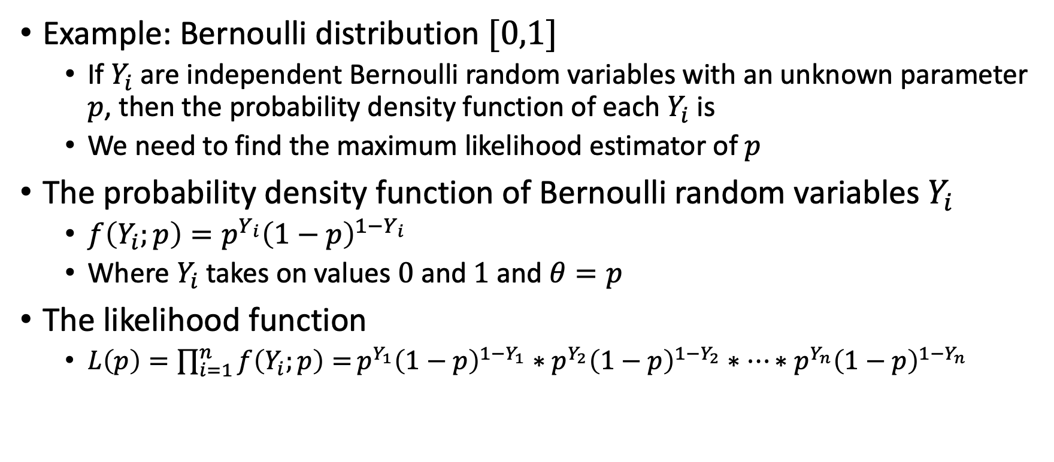
Maximum Likelihood Estimator
Example: Bernoulli distribution $[0,1]$
If $Y_{i}$ are independent Bernoulli random variables with an unknown parameter $p$, then the probability density function of each $Y_{i}$ is
We need to find the maximum likelihood estimator of $p$
The probability density function of Bernoulli random variables $Y_{i}$
$f\left(Y_{i};p\right)=p^{Y_{i}}{\left(1−p\right)}^{1−Y_{i}}$
Where $Y_{i}$ takes on values $0$ and $1$ and $θ=p$
The likelihood function
$L\left(p\right)=\prod_{i=1}^{n}{f\left(Y_{i};p\right)=}p^{Y_{1}}{\left(1−p\right)}^{1−Y_{1}}∗p^{Y_{2}}{\left(1−p\right)}^{1−Y_{2}}∗…∗p^{Y_{n}}{\left(1−p\right)}^{1−Y_{n}}$

Slide 10
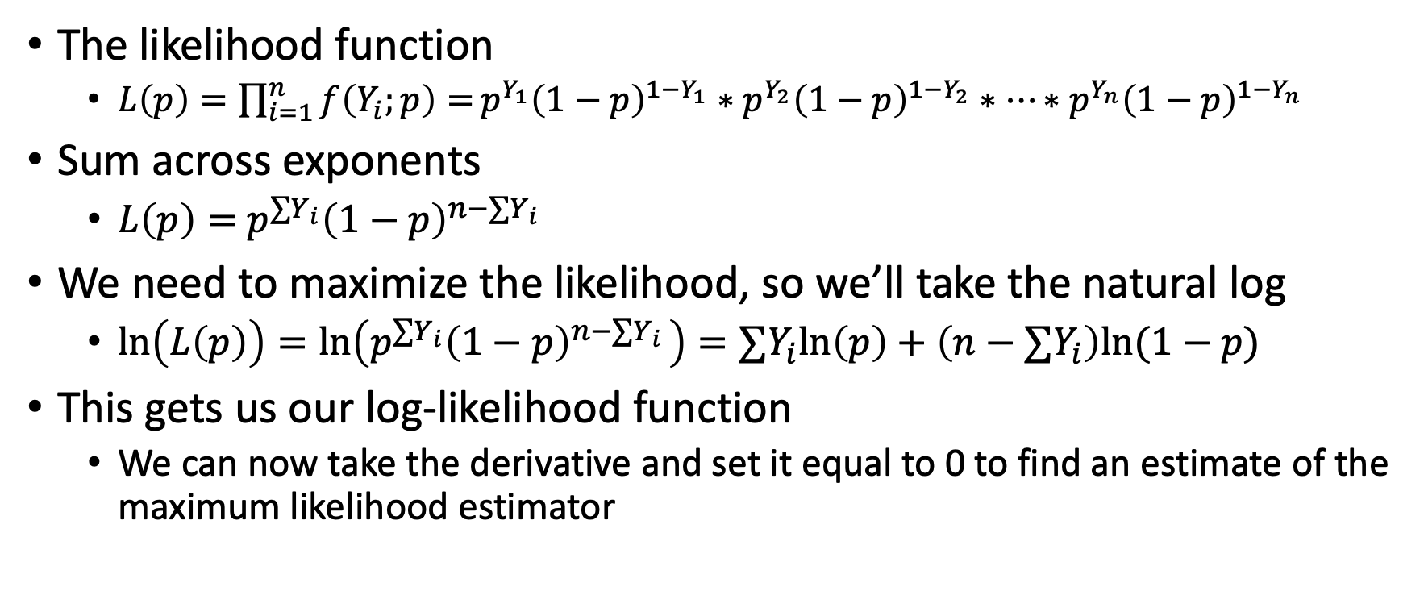
Maximum Likelihood Estimator
The likelihood function
$L\left(p\right)=\prod_{i=1}^{n}{f\left(Y_{i};p\right)=}p^{Y_{1}}{\left(1−p\right)}^{1−Y_{1}}∗p^{Y_{2}}{\left(1−p\right)}^{1−Y_{2}}∗…∗p^{Y_{n}}{\left(1−p\right)}^{1−Y_{n}}$
Sum across exponents
$L\left(p\right)=$ $p^{{∑Y}_{i}}{\left(1−p\right)}^{n−{∑Y}_{i }}$
We need to maximize the likelihood, so we’ll take the natural log
$\ln\left(L\left(p\right)\right)=\ln\left(p^{{∑Y}_{i}}{\left(1−p\right)}^{n−{∑Y}_{i }}\right)=∑Y_{i}ln\left(p\right)+\left(n−∑Y_{i}\right)ln(1−p)$
This gets us our log-likelihood function
We can now take the derivative and set it equal to 0 to find an estimate of the maximum likelihood estimator

Slide 11
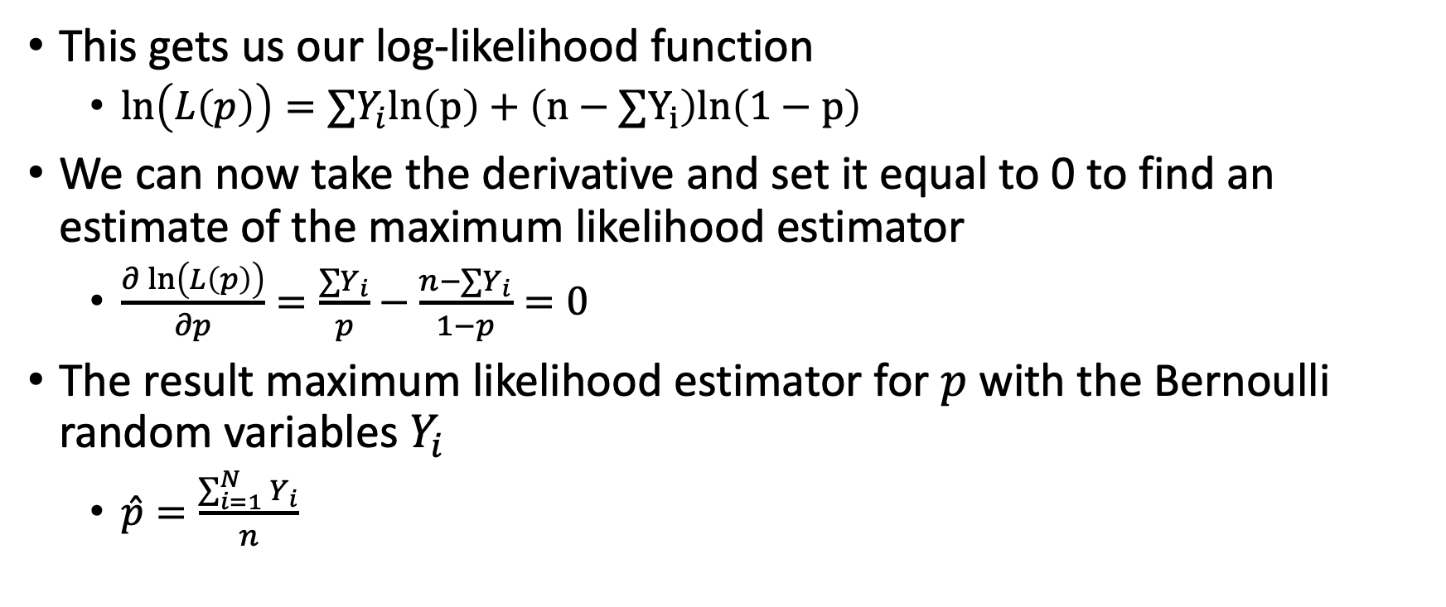
Maximum Likelihood Estimator
This gets us our log-likelihood function
$\ln\left(L\left(p\right)\right)=∑Y_{i}ln\left(p\right)+\left(n−∑Y_{i}\right)ln\left(1−p\right)$
We can now take the derivative and set it equal to 0 to find an estimate of the maximum likelihood estimator
$\frac{∂\ln\left(L\left(p\right)\right)}{∂p}=\frac{∑Y_{i}}{p}−\frac{n−∑Y_{i}}{1−p}=0$
The result maximum likelihood estimator for $p$with the Bernoulli random variables $Y_{i}$
$\hat{p}=\frac{\sum_{i=1}^{N}{Y_{i}}}{n}$

Slide 12
Maximum Likelihood Estimator
Note: We use OLS to get estimates of the linear probability model (LPM)
Note that under classical linear model assumption the OLS estimator is the maximum likelihood estimator conditioned on explanatory variables

Slide 13
Binary Dependent Variables

Slide 14
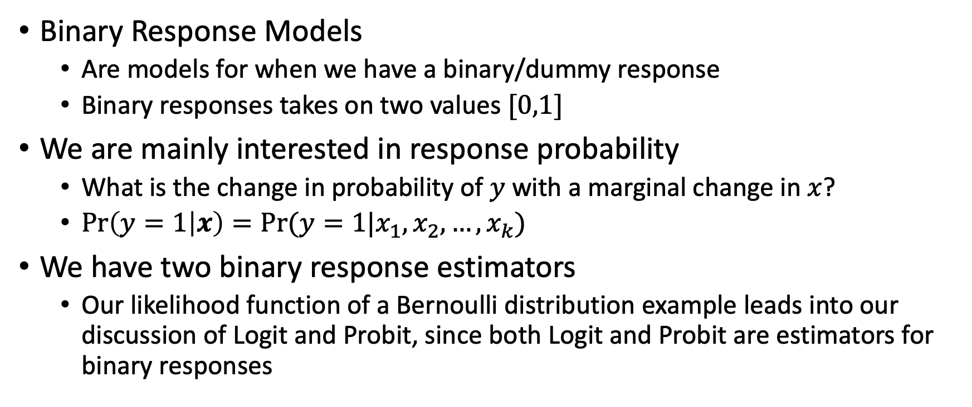
Binary Response Models
Binary Response Models
Are models for when we have a binary/dummy response
Binary responses takes on two values $[0,1]$
We are mainly interested in response probability
What is the change in probability of $y$ with a marginal change in $x$?
$\operatorname{Pr}\left(y=1 | x\right)=Pr⁡(y=1|x_{1},x_{2},…,x_{k})$
We have two binary response estimators
Our likelihood function of a Bernoulli distribution example leads into our discussion of Logit and Probit, since both Logit and Probit are estimators for binary responses

Slide 15
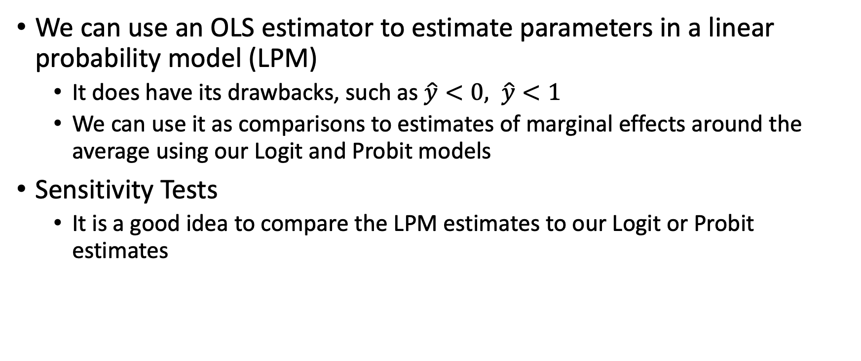
Binary Response Models
We can use an OLS estimator to estimate parameters in a linear probability model (LPM)
It does have its drawbacks, such as $\hat{y}<0, \hat{y}<1$
We can use it as comparisons to estimates of marginal effects around the average using our Logit and Probit models
Sensitivity Tests
It is a good idea to compare the LPM estimates to our Logit or Probit estimates

Slide 16
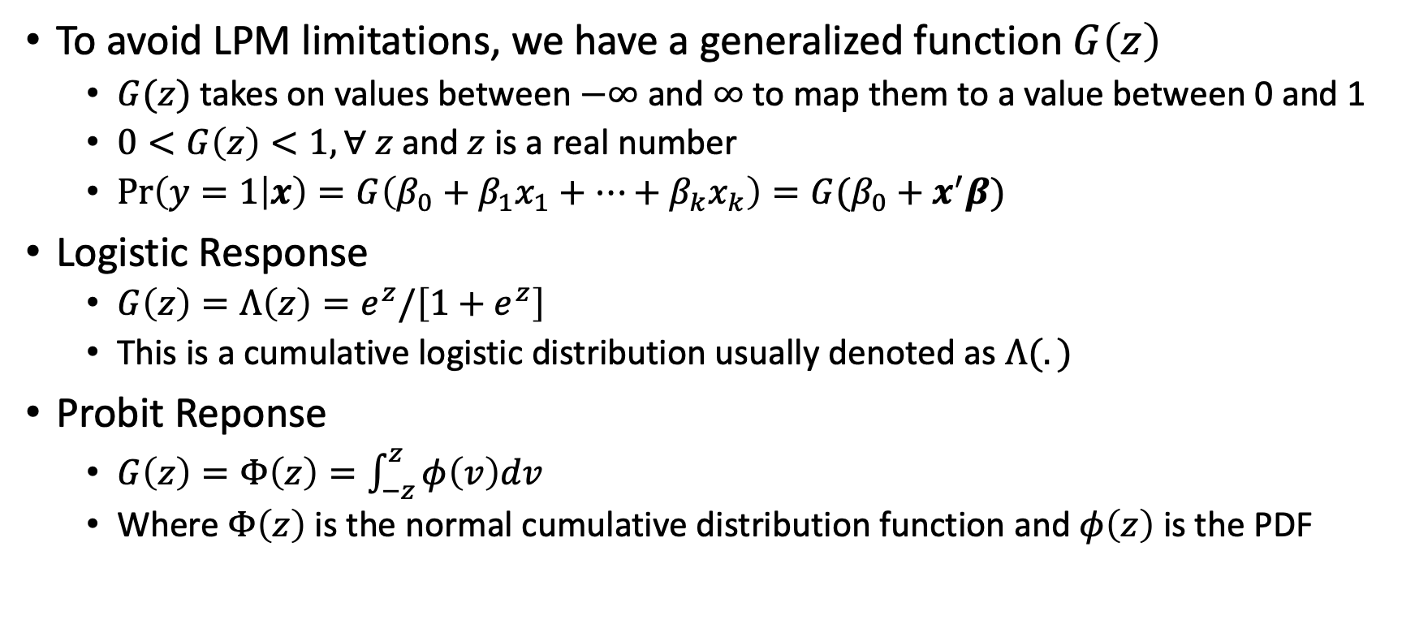
Binary Response Models
To avoid LPM limitations, we have a generalized function $G\left(z\right)$
$G(z)$ takes on values between $−∞$ and $∞$ to map them to a value between 0 and 1
$0<G\left(z\right)<1, ∀ z$ and $z$ is a real number
$\operatorname{Pr}\left(y=1 | x\right)=G\left(β_{0}+β_{1}x_{1}+…+β_{k}x_{k}\right)=G(β_{0}+x^{′}β)$
Logistic Response
$G\left(z\right)=Λ\left(z\right)=e^{z}/\left[1+e^{z}\right]$
This is a cumulative logistic distribution usually denoted as $Λ(.)$
Probit Reponse
$G\left(z\right)=Φ\left(z\right)=\int_{−z}^{z}{φ\left(v\right)dv}$
Where $Φ\left(z\right)$ is the normal cumulative distribution function and $φ\left(z\right)$ is the PDF

Slide 17
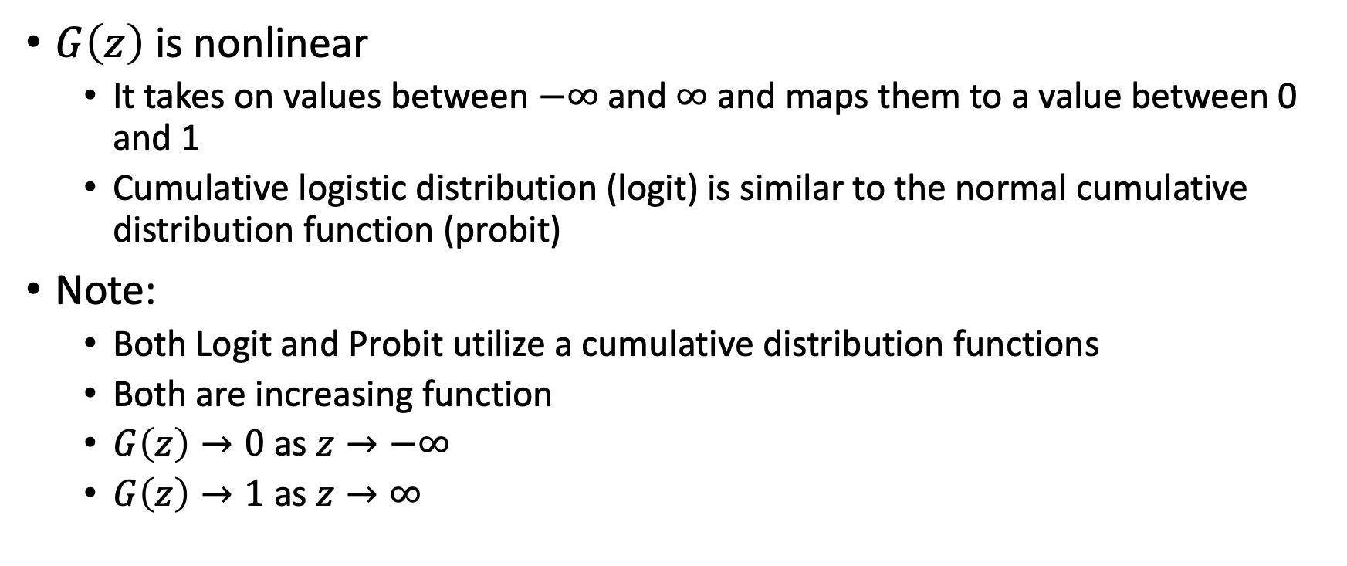
Binary Response Models
$G\left(z\right)$ is nonlinear
It takes on values between $−∞$ and $∞$ and maps them to a value between 0 and 1
Cumulative logistic distribution (logit) is similar to the normal cumulative distribution function (probit)
Note:
Both Logit and Probit utilize a cumulative distribution functions
Both are increasing function
$G\left(z\right)→0$ as $z→−∞$
$G\left(z\right)→1$ as $z→∞$

Slide 18
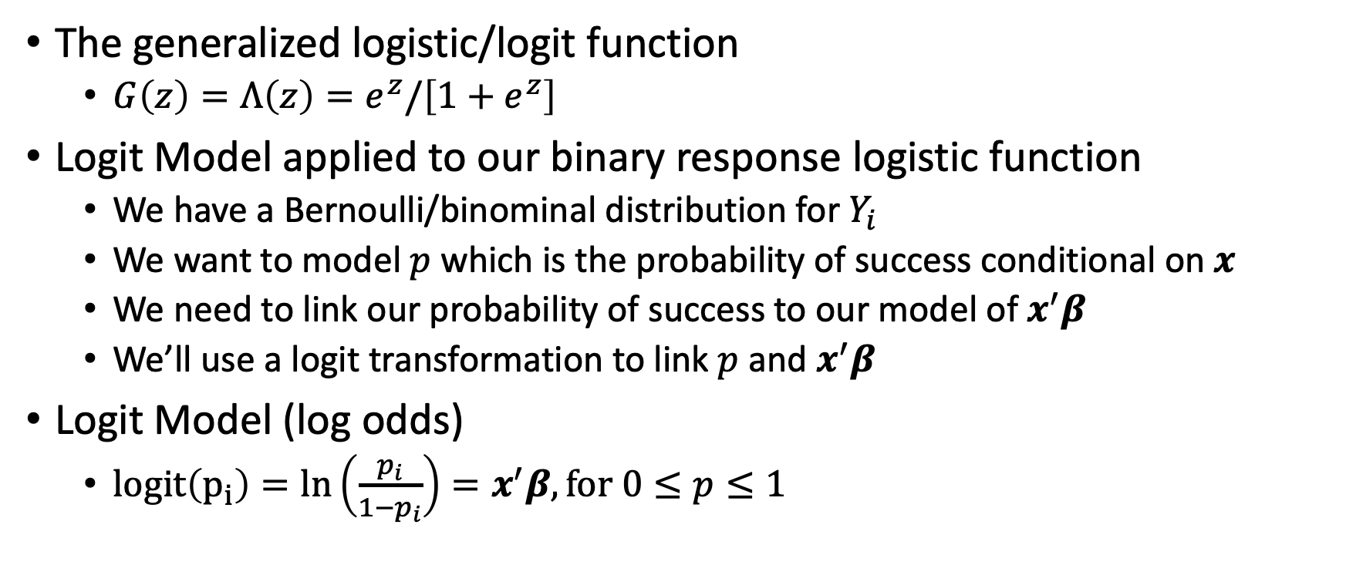
Logit Model
The generalized logistic/logit function
$G\left(z\right)=Λ\left(z\right)=e^{z}/\left[1+e^{z}\right]$
Logit Model applied to our binary response logistic function
We have a Bernoulli/binominal distribution for $Y_{i}$
We want to model $p$ which is the probability of success conditional on $x$
We need to link our probability of success to our model of $x^{′}β$
We’ll use a logit transformation to link $p$ and $x^{′}β$
Logit Model (log odds)
$logit\left(p_{i}\right)=ln\left(\frac{p_{i}}{1−p_{i}}\right)=x^{′}β, for 0≤p≤1$

Slide 19
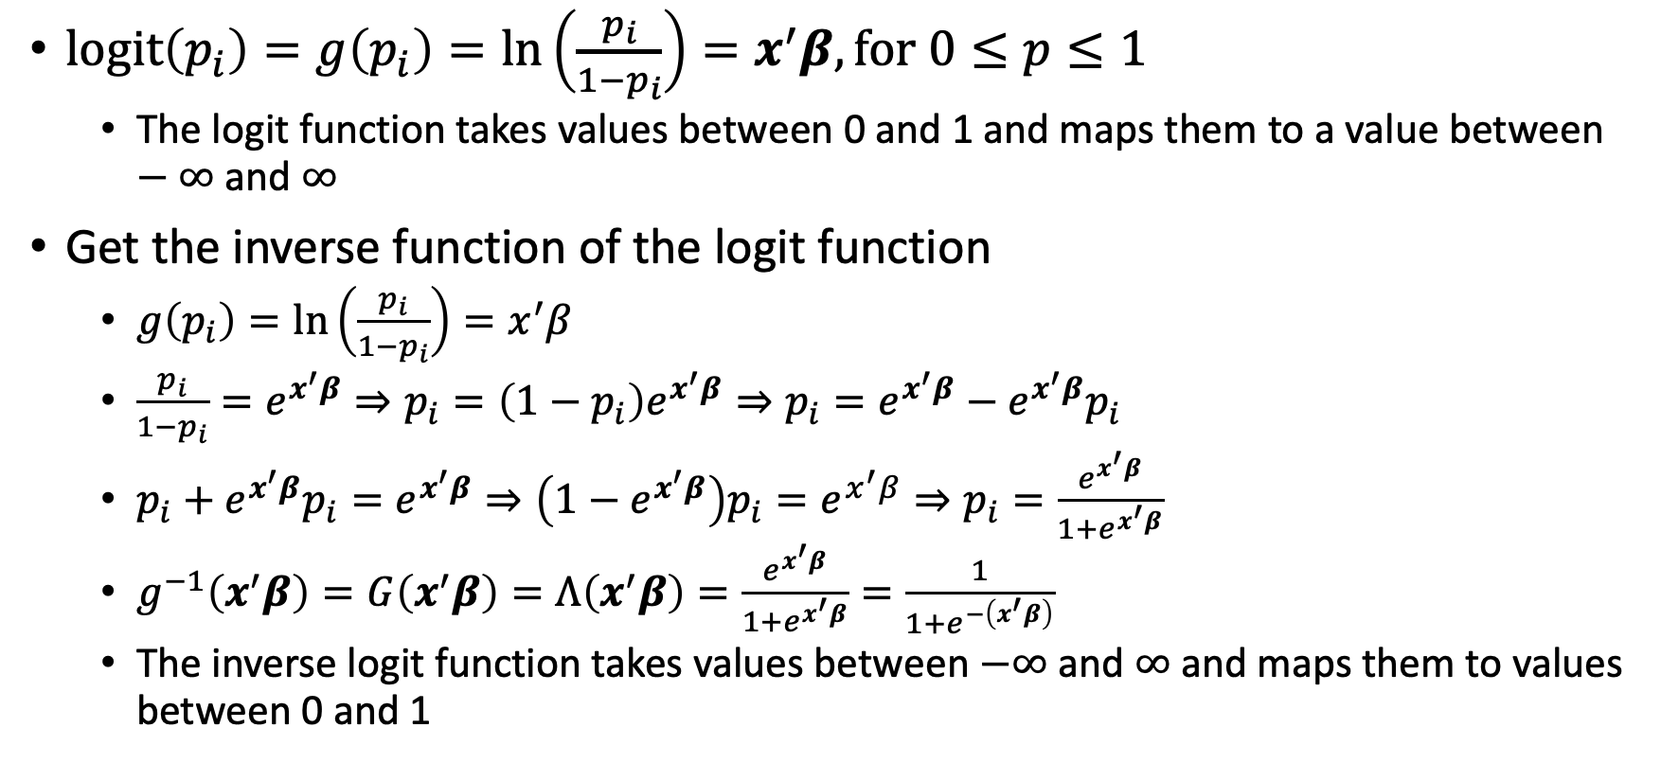
Logit Transformation
$logit\left(p_{i}\right)=g\left(p_{i}\right)=ln\left(\frac{p_{i}}{1−p_{i}}\right)=x^{′}β, for 0≤p≤1$
The logit function takes values between 0 and 1 and maps them to a value between $−∞$ and $∞$
Get the inverse function of the logit function
$g\left(p_{i}\right)=\ln\left(\frac{p_{i}}{1−p_{i}}\right)=x^{′}β$
$\frac{p_{i}}{1−p_{i}}=e^{x^{′}β}⇒p_{i}=\left(1−p_{i}\right)e^{x^{′}β}⇒p_{i}=e^{x^{′}β}−e^{x^{′}β}p_{i}$
$p_{i}+e^{x^{′}β}p_{i}=e^{x^{′}β}⇒\left(1−e^{x^{′}β}\right)p_{i}=e^{x^{′}β}⇒p_{i}=\frac{e^{x^{′}β}}{1+e^{x^{′}β}}$
$g^{−1}\left(x^{′}β\right)=G\left(x^{′}β\right)=Λ\left(x^{′}β\right)=\frac{e^{x^{′}β}}{1+e^{x^{′}β}}=\frac{1}{1+e^{−\left(x^{′}β\right)}}$
The inverse logit function takes values between $−∞$ and $∞$ and maps them to values between 0 and 1

Slide 20
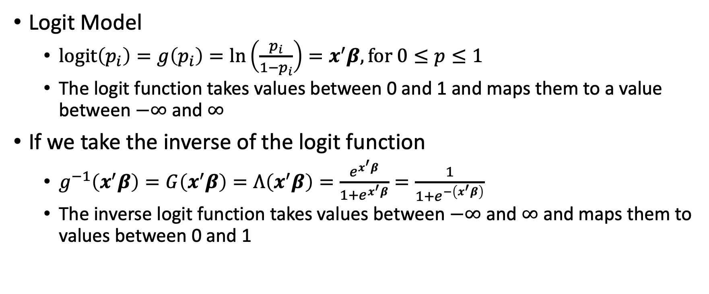
Logit Model
Logit Model
$logit\left(p_{i}\right)=g\left(p_{i}\right)=ln\left(\frac{p_{i}}{1−p_{i}}\right)=x^{′}β, for 0≤p≤1$
The logit function takes values between 0 and 1 and maps them to a value between $−∞$ and $∞$
If we take the inverse of the logit function
$g^{−1}\left(x^{′}β\right)=G\left(x^{′}β\right)=Λ\left(x^{′}β\right)=\frac{e^{x^{′}β}}{1+e^{x^{′}β}}=\frac{1}{1+e^{−\left(x^{′}β\right)}}$
The inverse logit function takes values between $−∞$ and $∞$ and maps them to values between 0 and 1

Slide 21
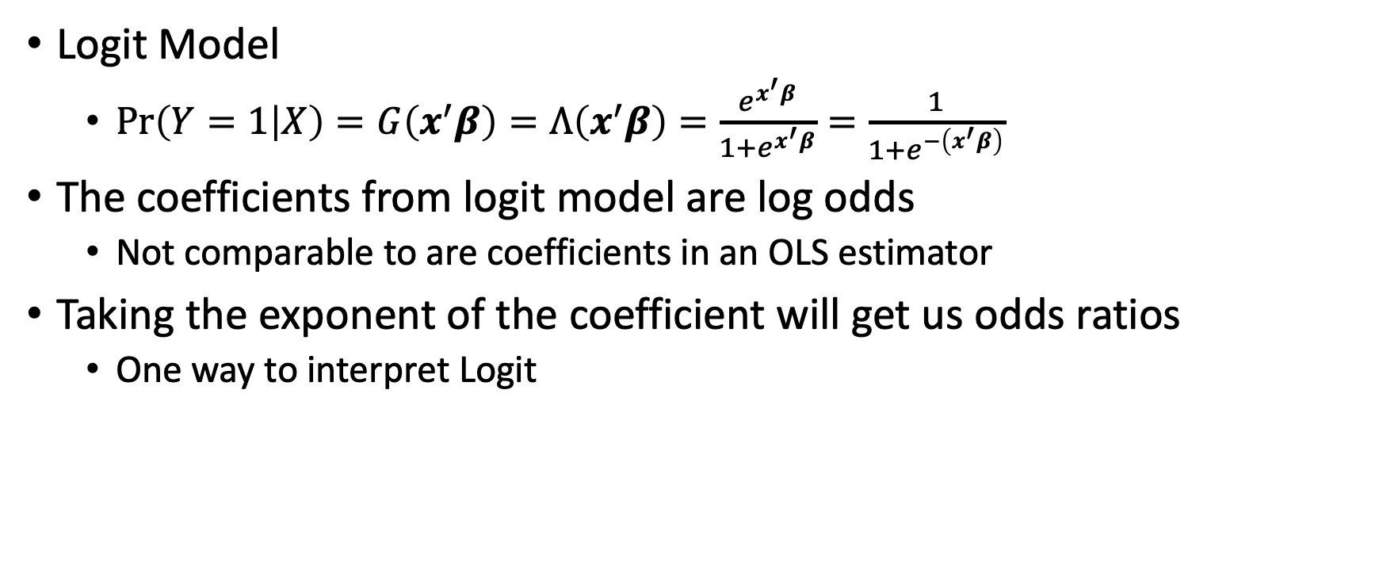
Logit Model
Logit Model
$\operatorname{Pr}\left(Y=1 | X\right)=G\left(x^{′}β\right)=Λ\left(x^{′}β\right)=\frac{e^{x^{′}β}}{1+e^{x^{′}β}}=\frac{1}{1+e^{−\left(x^{′}β\right)}}$
The coefficients from logit model are log odds
Not comparable to are coefficients in an OLS estimator
Taking the exponent of the coefficient will get us odds ratios
One way to interpret Logit

Slide 22
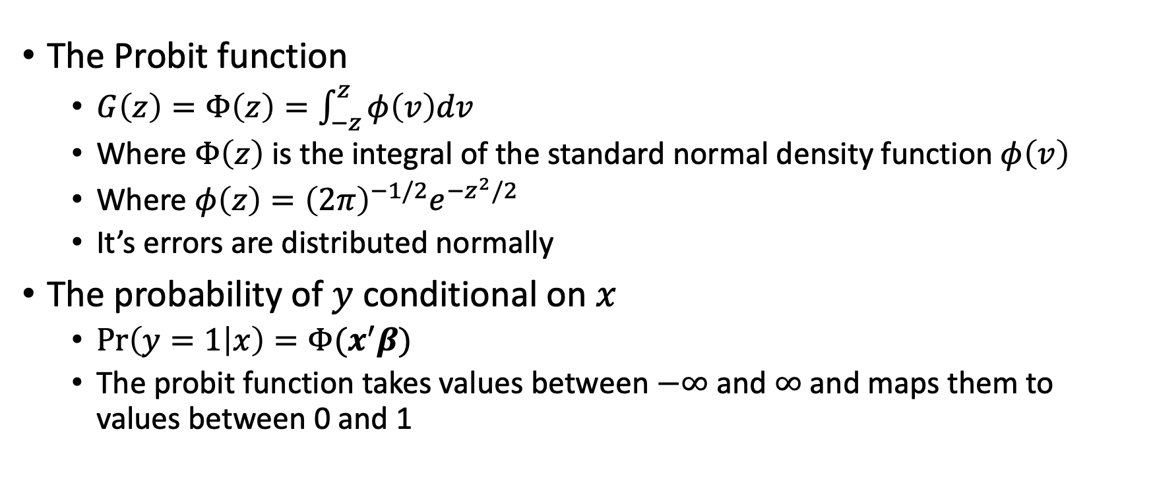
Probit Model
The Probit function
$G\left(z\right)=Φ\left(z\right)=\int_{−z}^{z}{φ\left(v\right)dv}$
Where $Φ\left(z\right)$ is the integral of the standard normal density function $φ\left(v\right)$
Where $φ\left(z\right)={\left(2π\right)}^{−1/2}e^{−z^{2}/2}$
It’s errors are distributed normally
The probability of $y$ conditional on $x$
$\operatorname{Pr}\left(y=1 | x\right)=Φ(x^{′}β)$
The probit function takes values between $−∞$ and $∞$ and maps them to values between 0 and 1

Slide 23
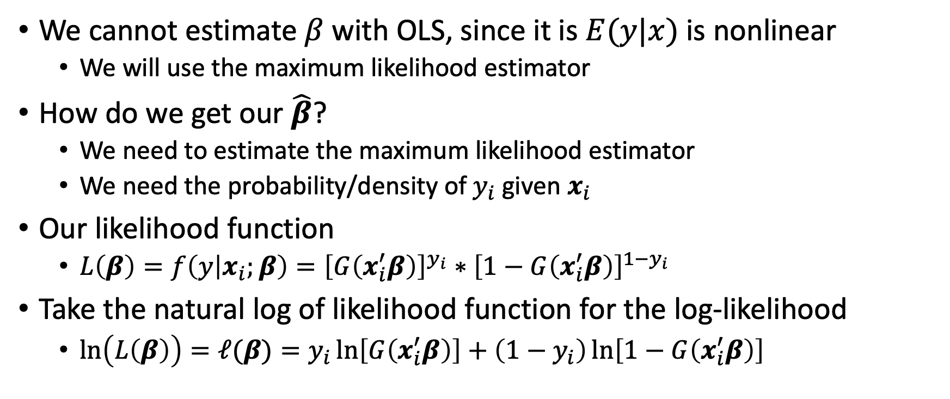
Maximum Likelihood Estimator
We cannot estimate $β$ with OLS, since it is $E(y|x)$ is nonlinear
We will use the maximum likelihood estimator
How do we get our $\hat{β}$?
We need to estimate the maximum likelihood estimator
We need the probability/density of $y_{i}$ given $x_{i}$
Our likelihood function
$L\left(β\right)=f\left(y | x_{i};β\right)={\left[G\left(x_{i}^{′}β\right)\right]}^{y_{i}}∗{\left[1−G\left(x_{i}^{′}β\right)\right]}^{1−y_{i}}$
Take the natural log of likelihood function for the log-likelihood
$\ln\left(L\left(β\right)\right)=ℓ(β)=y_{i}\ln\left[G\left(x_{i}^{′}β\right)\right]+\left(1−y_{i}\right)\ln\left[1−G\left(x_{i}^{′}β\right)\right]$

Slide 24
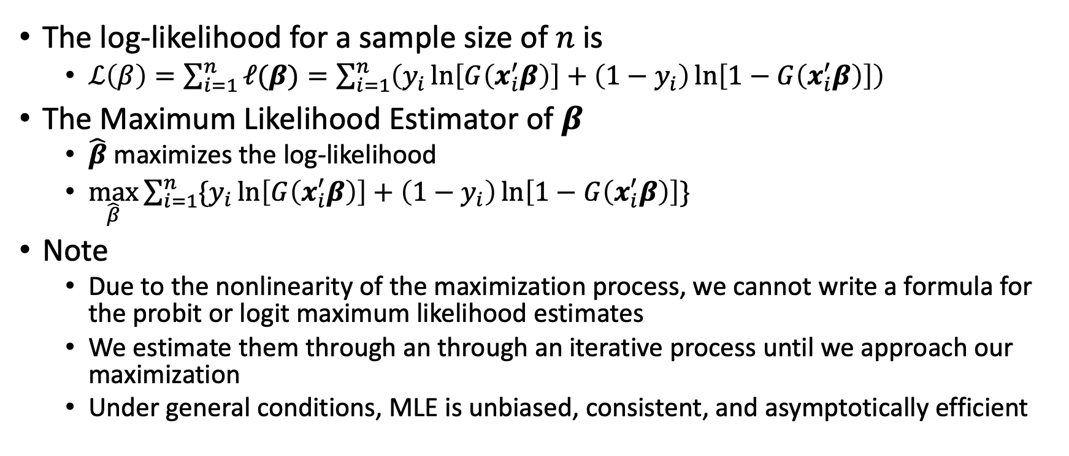
Maximum Likelihood Estimator
The log-likelihood for a sample size of $n$ is
$ℒ\left(β\right)=\sum_{i=1}^{n}{ℓ(β)}=\sum_{i=1}^{n}{\left(y_{i}\ln\left[G\left(x_{i}^{′}β\right)\right]+\left(1−y_{i}\right)\ln\left[1−G\left(x_{i}^{′}β\right)\right]\right)}$
The Maximum Likelihood Estimator of $β$
$\hat{β}$ maximizes the log-likelihood
$\max_{\hat{β}}{\sum_{i=1}^{n}{\{y_{i}\ln\left[G\left(x_{i}^{′}β\right)\right]+\left(1−y_{i}\right)\ln\left[1−G\left(x_{i}^{′}β\right)\right]\}}}$
Note
Due to the nonlinearity of the maximization process, we cannot write a formula for the probit or logit maximum likelihood estimates
We estimate them through an through an iterative process until we approach our maximization
Under general conditions, MLE is unbiased, consistent, and asymptotically efficient

Slide 25
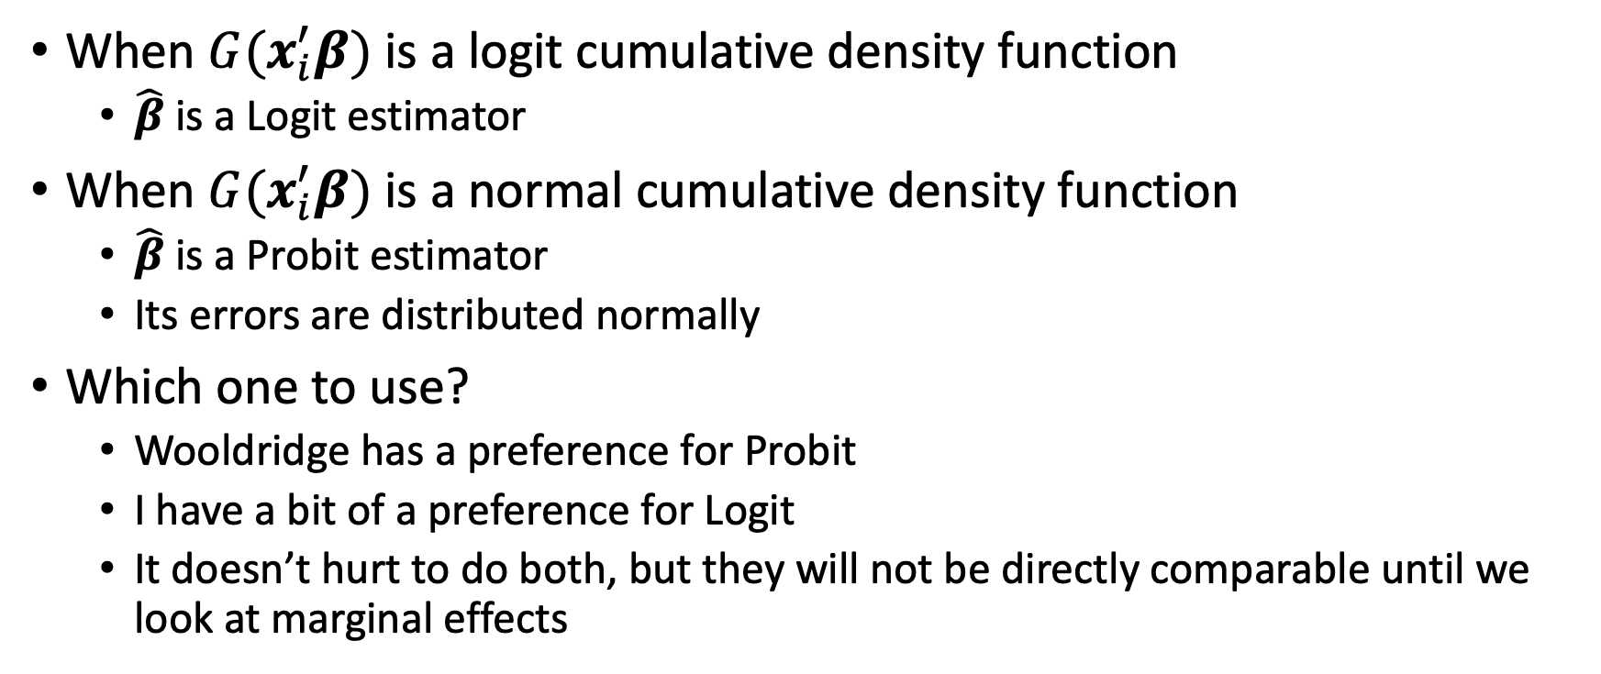
Logit vs Probit
When $G(x_{i}^{′}β)$ is a logit cumulative density function
$\hat{β}$ is a Logit estimator
When $G(x_{i}^{′}β)$ is a normal cumulative density function
$\hat{β}$ is a Probit estimator
Its errors are distributed normally
Which one to use?
Wooldridge has a preference for Probit
I have a bit of a preference for Logit
It doesn’t hurt to do both, but they will not be directly comparable until we look at marginal effects

Slide 26
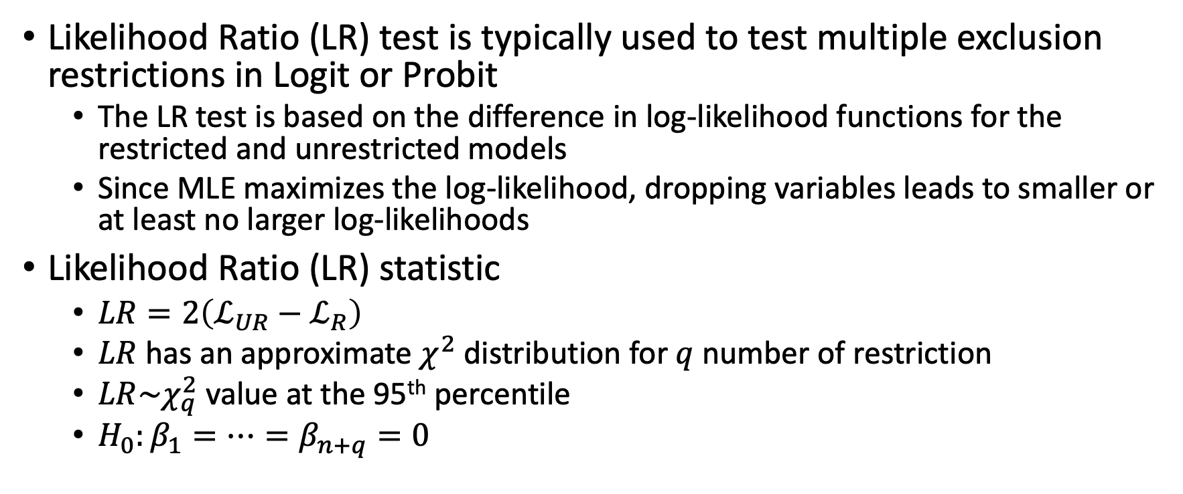
Testing Restrictions
Likelihood Ratio (LR) test is typically used to test multiple exclusion restrictions in Logit or Probit
The LR test is based on the difference in log-likelihood functions for the restricted and unrestricted models
Since MLE maximizes the log-likelihood, dropping variables leads to smaller or at least no larger log-likelihoods
Likelihood Ratio (LR) statistic
$LR=2\left(ℒ_{UR}−ℒ_{R}\right)$
$LR$ has an approximate $χ^{2}$ distribution for $q$ number of restriction
$LR\sim χ_{q}^{2}$ value at the 95th percentile
$H_{0}:β_{1}=…=β_{n+q}=0$

Slide 27
Interpreting Logit and Probit
Since our models are nonlinear, no approach to interpretation will full describe the relationship
There are few ways to interpret the regression coefficients from logit and probit
Odds Ratios
Predicted Probabilities
Marginal Effects

Slide 28
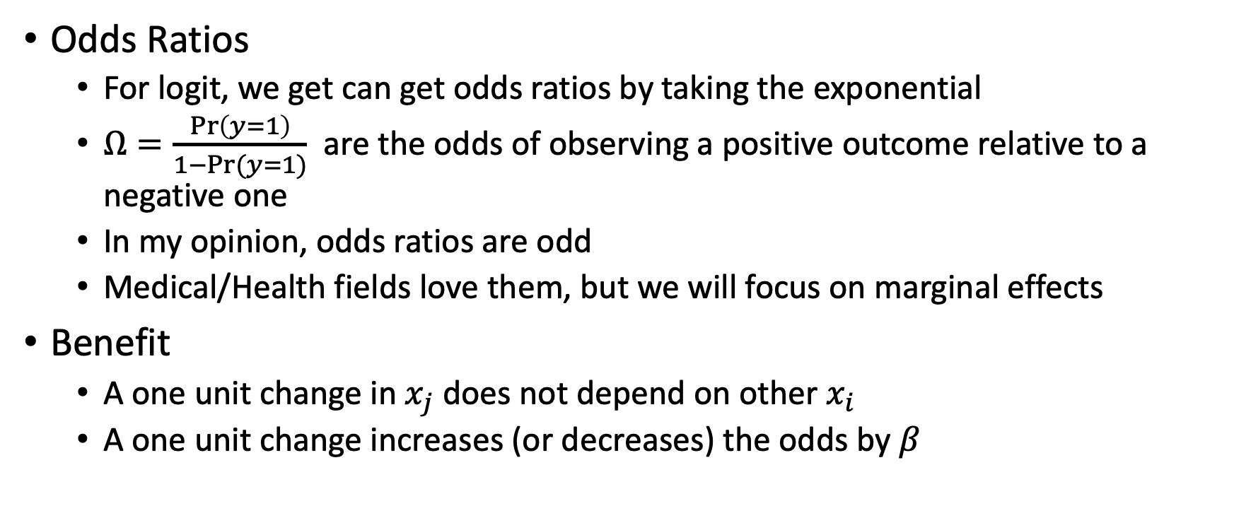
Interpreting Logit and Probit
Odds Ratios
For logit, we get can get odds ratios by taking the exponential
$Ω=\frac{\operatorname{Pr}\left(y=1\right)}{1−Pr⁡(y=1)}$ are the odds of observing a positive outcome relative to a negative one
In my opinion, odds ratios are odd
Medical/Health fields love them, but we will focus on marginal effects
Benefit
A one unit change in $x_{j}$ does not depend on other $x_{i}$
A one unit change increases (or decreases) the odds by $β$

Slide 29
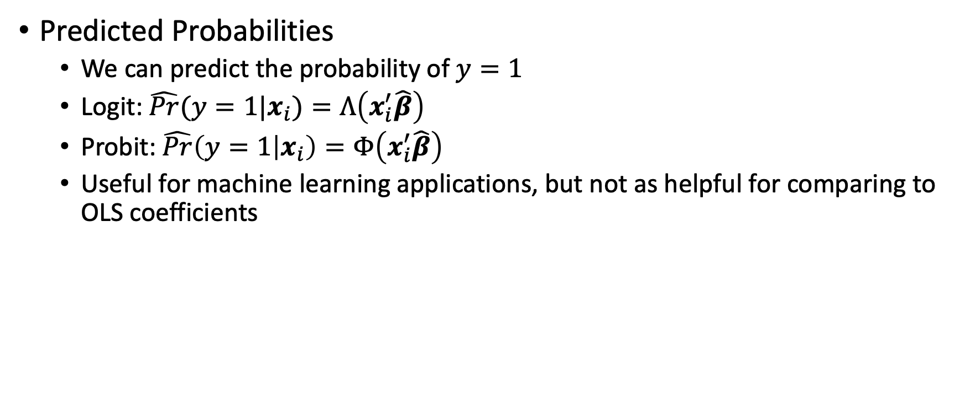
Interpreting Logit and Probit
Predicted Probabilities
We can predict the probability of $y=1$
Logit: $\hat{Pr}(y=1|x_{i})=Λ\left(x_{i}^{′}\hat{β}\right)$
Probit: $\hat{Pr}\left(y=1 | x_{i}\right)=Φ\left(x_{i}^{′}\hat{β}\right)$
Useful for machine learning applications, but not as helpful for comparing to OLS coefficients

Slide 30
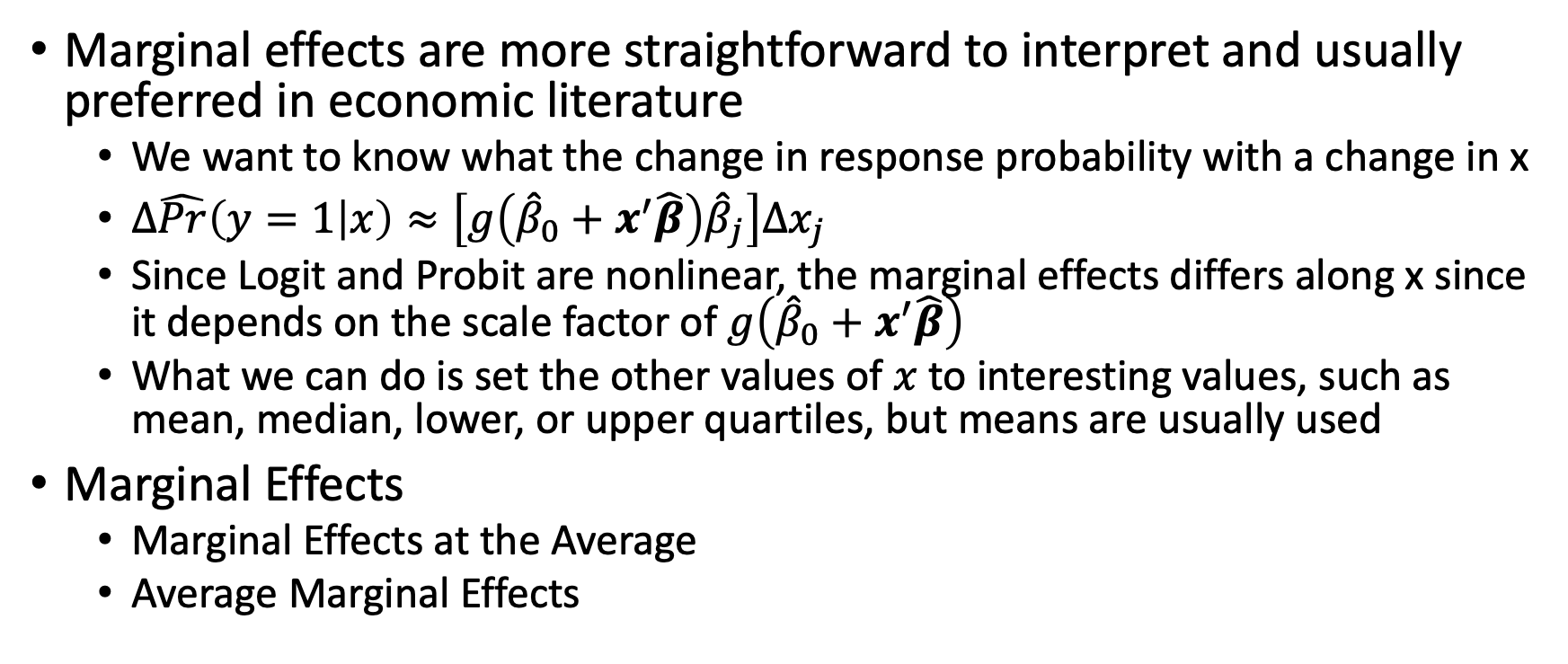
Marginal Effects
Marginal effects are more straightforward to interpret and usually preferred in economic literature
We want to know what the change in response probability with a change in x
$Δ\hat{Pr}\left(y=1 | x\right)≈\left[g\left({\hat{β}}_{0}+x^{′}\hat{β}\right){\hat{β}}_{j}\right]Δx_{j}$
Since Logit and Probit are nonlinear, the marginal effects differs along x since it depends on the scale factor of $g\left({\hat{β}}_{0}+x^{′}\hat{β}\right)$
What we can do is set the other values of $x$ to interesting values, such as mean, median, lower, or upper quartiles, but means are usually used
Marginal Effects
Marginal Effects at the Average
Average Marginal Effects

Slide 31
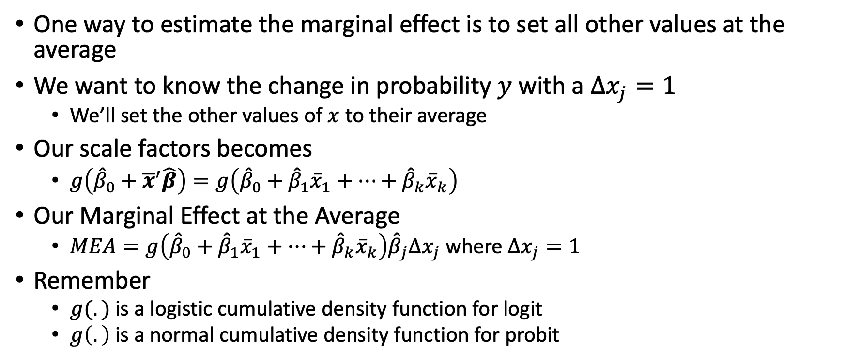
Marginal Effects at the Average
One way to estimate the marginal effect is to set all other values at the average
We want to know the change in probability $y$ with a $Δx_{j}=1$
We’ll set the other values of $x$ to their average
Our scale factors becomes
$g\left({\hat{β}}_{0}+{\overline{x}}^{′}\hat{β}\right)=g\left({\hat{β}}_{0}+{\hat{β}}_{1}{\overline{x}}_{1}+…+{\hat{β}}_{k}{\overline{x}}_{k}\right)$
Our Marginal Effect at the Average
$MEA=g\left({\hat{β}}_{0}+{\hat{β}}_{1}{\overline{x}}_{1}+…+{\hat{β}}_{k}{\overline{x}}_{k}\right){\hat{β}}_{j}Δx_{j}$ where $Δx_{j}=1$
Remember
$g(.)$ is a logistic cumulative density function for logit
$g\left(.\right)$ is a normal cumulative density function for probit

Slide 32
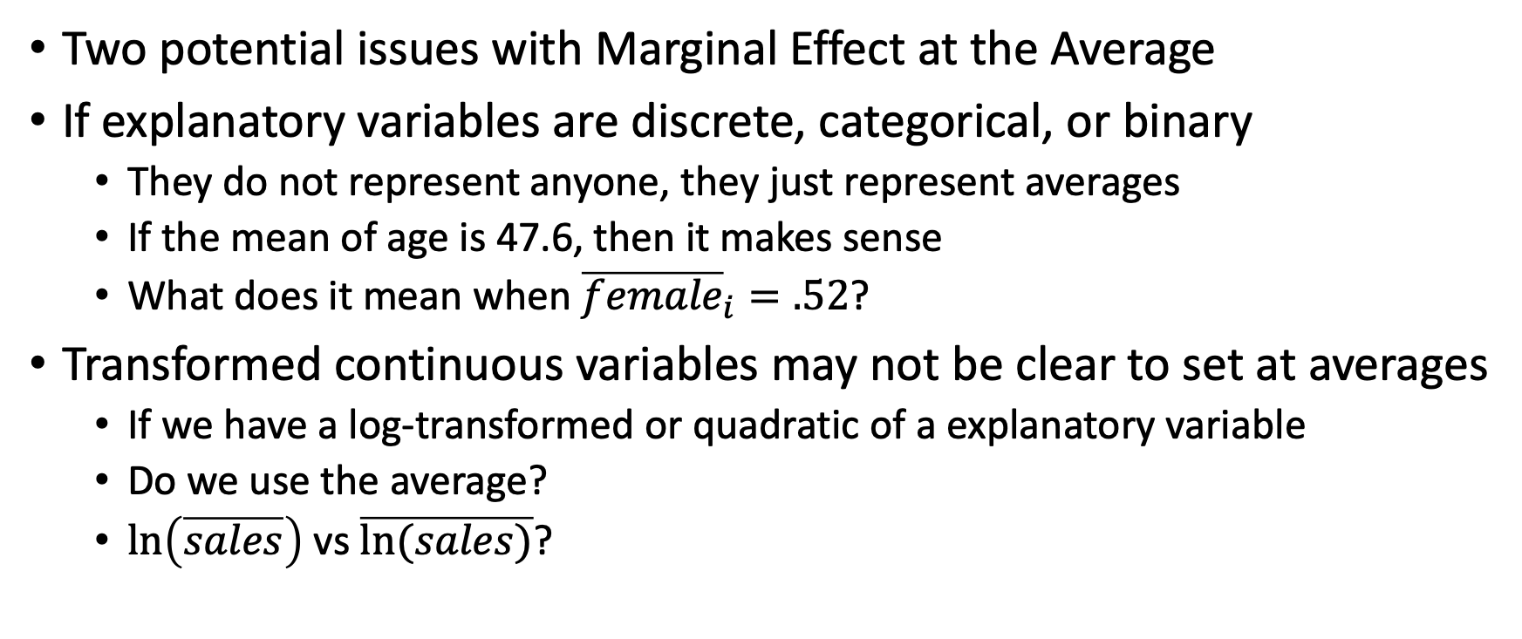
Marginal Effects at the Average
Two potential issues with Marginal Effect at the Average
If explanatory variables are discrete, categorical, or binary
They do not represent anyone, they just represent averages
If the mean of age is 47.6, then it makes sense
What does it mean when ${\overline{female}}_{i}=.52$?
Transformed continuous variables may not be clear to set at averages
If we have a log-transformed or quadratic of a explanatory variable
Do we use the average?
$\ln\left(\overline{sales}\right)$ vs $\overline{ln⁡(sales)}$?

Slide 33
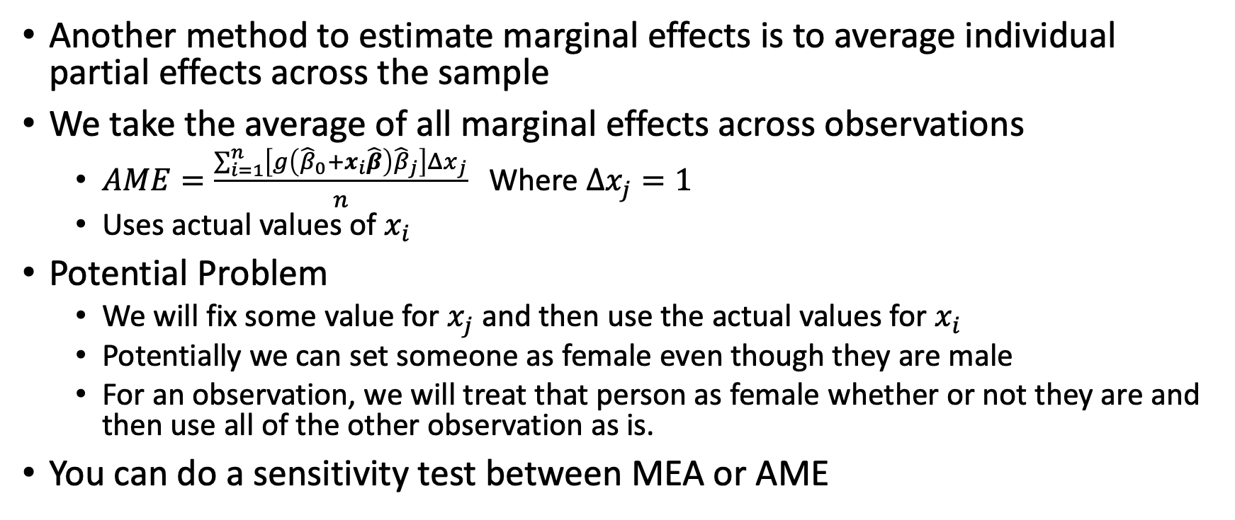
Average Marginal Effects
Another method to estimate marginal effects is to average individual partial effects across the sample
We take the average of all marginal effects across observations
$AME=\frac{\sum_{i=1}^{n}{\left[g\left({\hat{β}}_{0}+x_{i}\hat{β}\right){\hat{β}}_{j}\right]}Δx_{j}}{n}$Where $Δx_{j}=1$
Uses actual values of $x_{i}$
Potential Problem
We will fix some value for $x_{j}$ and then use the actual values for $x_{i}$
Potentially we can set someone as female even though they are male
For an observation, we will treat that person as female whether or not they are and then use all of the other observation as is.
You can do a sensitivity test between MEA or AME

Slide 34
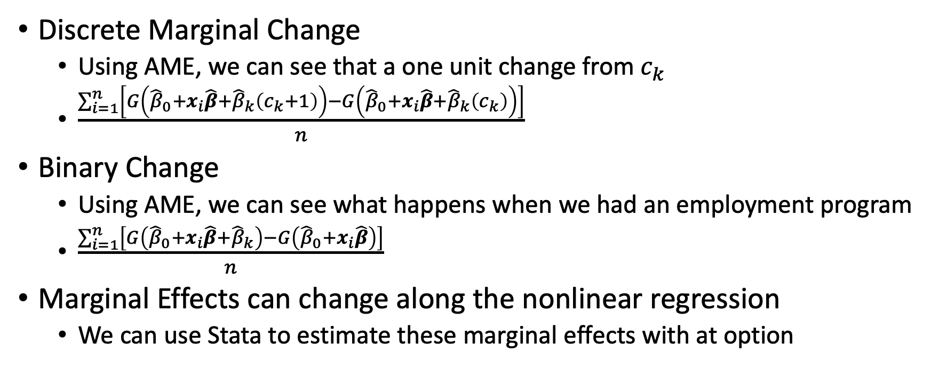
Marginal Effects
Discrete Marginal Change
Using AME, we can see that a one unit change from $c_{k}$
$\frac{\sum_{i=1}^{n}{\left[G\left({\hat{β}}_{0}+x_{i}\hat{β}+{\hat{β}}_{k}\left(c_{k}+1\right)\right)−G\left({\hat{β}}_{0}+x_{i}\hat{β}+{\hat{β}}_{k}\left(c_{k}\right)\right)\right]}}{n}$
Binary Change
Using AME, we can see what happens when we had an employment program
$\frac{\sum_{i=1}^{n}{\left[G\left({\hat{β}}_{0}+x_{i}\hat{β}+{\hat{β}}_{k}\right)−G\left({\hat{β}}_{0}+x_{i}\hat{β}\right)\right]}}{n}$
Marginal Effects can change along the nonlinear regression
We can use Stata to estimate these marginal effects with at option

Slide 35
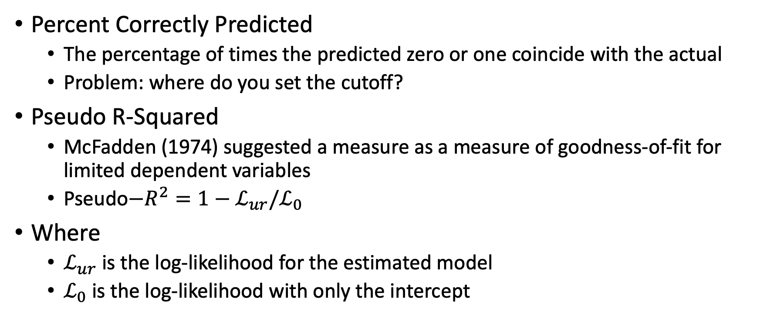
Goodness-of-Fit
Percent Correctly Predicted
The percentage of times the predicted zero or one coincide with the actual
Problem: where do you set the cutoff?
Pseudo R-Squared
McFadden (1974) suggested a measure as a measure of goodness-of-fit for limited dependent variables
Pseudo$−R^{2}=1−ℒ_{ur}/ℒ_{0}$
Where
$ℒ_{ur}$ is the log-likelihood for the estimated model
$ℒ_{0}$ is the log-likelihood with only the intercept

Slide 36
Further readings on Logit and Probit
Multinomial Logit
When we have a categorical variable as an outcome
Example: Employed, Unemployed, and Not in the Labor Force
We’ll cover this next
Ordinal Logit
We have a categorical outcomes that has ordinal values (or rank values)
I recommend Regression Models for Categorical Dependent Variables Using Stata
Long and Freese
There is a 2014 edition with margins command
There is also a 2005 edition with the old mfx command, but odds ratios and predicted probabilities are the same

Slide 37
Nominal Dependent Variables
Long and Freese (2006); Williams (2022)

Slide 38
Nominal Dependent Variable
Nominal Dependent Variable
Categorical responses with no ranked order
Ex: If we are interested in marital status as an outcome, then we have several categories - married, never married, divorced, widowed, or separated
Alternative will refer to a possible outcome in the category (as seen above)
Choice will be the alternative that is observed (choosing an alternative)
Multinomial Logit Model
We estimate a separate binary logit for reach pair of outcome categories
Nominal vs Ordinal Outcome
We need to be careful about ordinality in the categorical dependent variable
Ordinal Logit or Probit for ordinal dependent outcomes

Slide 39
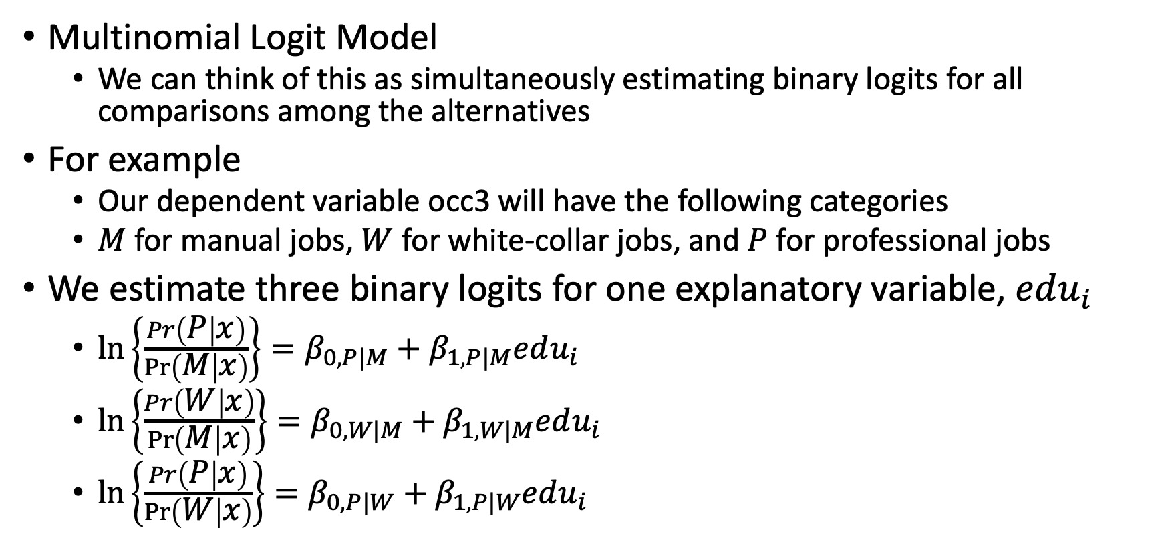
Multinomial Logit Model
Multinomial Logit Model
We can think of this as simultaneously estimating binary logits for all comparisons among the alternatives
For example
Our dependent variable occ3 will have the following categories
$M$ for manual jobs, $W$ for white-collar jobs, and $P$ for professional jobs
We estimate three binary logits for one explanatory variable, $edu_{i}$
$\ln\left\{\frac{Pr\left(P | x\right)}{\operatorname{Pr}\left(M | x\right)}\right\}=β_{0,P|M}+β_{1,P|M}edu_{i}$
$\ln\left\{\frac{Pr\left(W | x\right)}{\operatorname{Pr}\left(M | x\right)}\right\}=β_{0,W|M}+β_{1,W|M}edu_{i}$
$\ln\left\{\frac{Pr\left(P | x\right)}{\operatorname{Pr}\left(W | x\right)}\right\}=β_{0,P|W}+β_{1,P|W}edu_{i}$

Slide 40
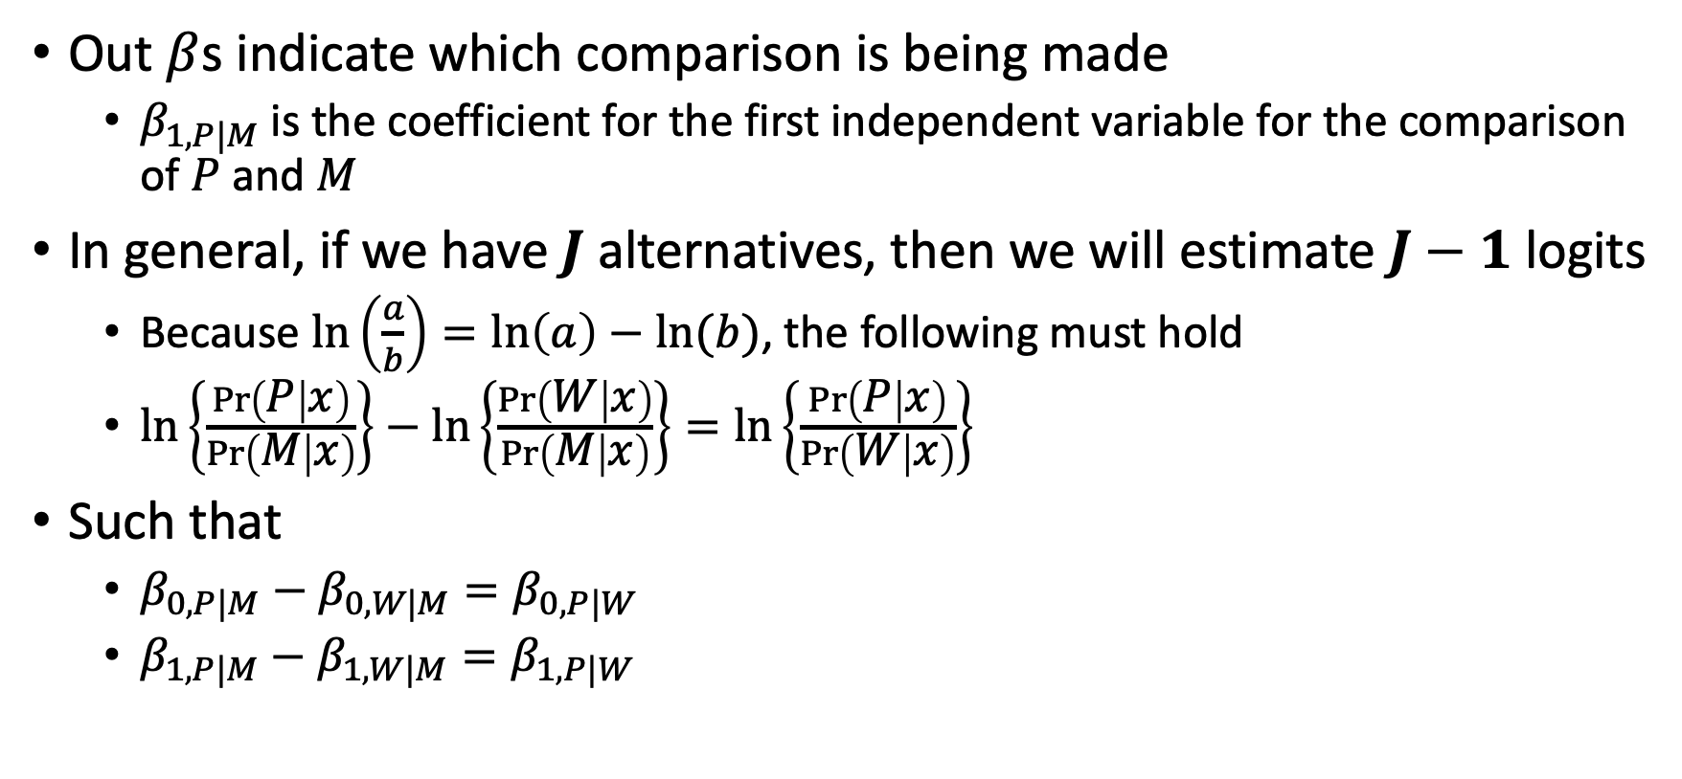
Multinomial Logit Model
Out $β$s indicate which comparison is being made
$β_{1,P|M}$ is the coefficient for the first independent variable for the comparison of $P$ and $M$
In general, if we have $J$ alternatives, then we will estimate $J−1$ logits
Because $\ln\left(\frac{a}{b}\right)=\ln\left(a\right)−ln⁡(b)$, the following must hold
$\ln\left\{\frac{\operatorname{Pr}\left(P | x\right)}{\operatorname{Pr}\left(M | x\right)}\right\}−\ln\left\{\frac{\operatorname{Pr}\left(W | x\right)}{\operatorname{Pr}\left(M | x\right)}\right\}=\ln\left\{\frac{\operatorname{Pr}\left(P | x\right)}{\operatorname{Pr}\left(W | x\right)}\right\}$
Such that
$β_{0,P|M}−β_{0,W|M}=β_{0,P|W}$
$β_{1,P|M}−β_{1,W|M}=β_{1,P|W}$

Slide 41
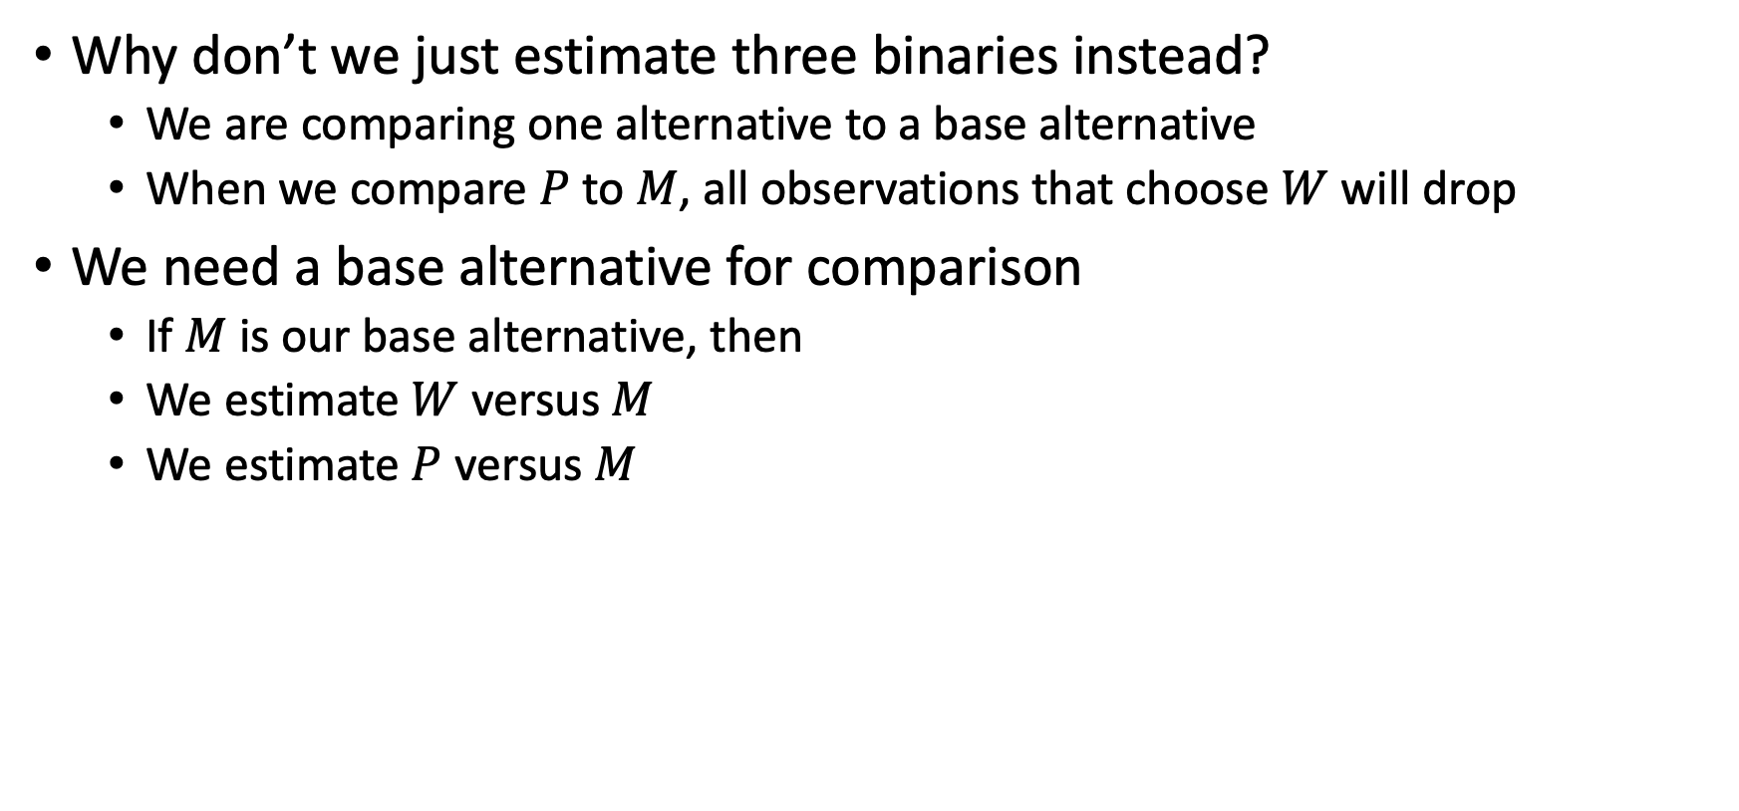
Multinomial Logit Model
Why don’t we just estimate three binaries instead?
We are comparing one alternative to a base alternative
When we compare $P$ to $M$, all observations that choose $W$ will drop
We need a base alternative for comparison
If $M$ is our base alternative, then
We estimate $W$ versus $M$
We estimate $P$ versus $M$

Slide 42
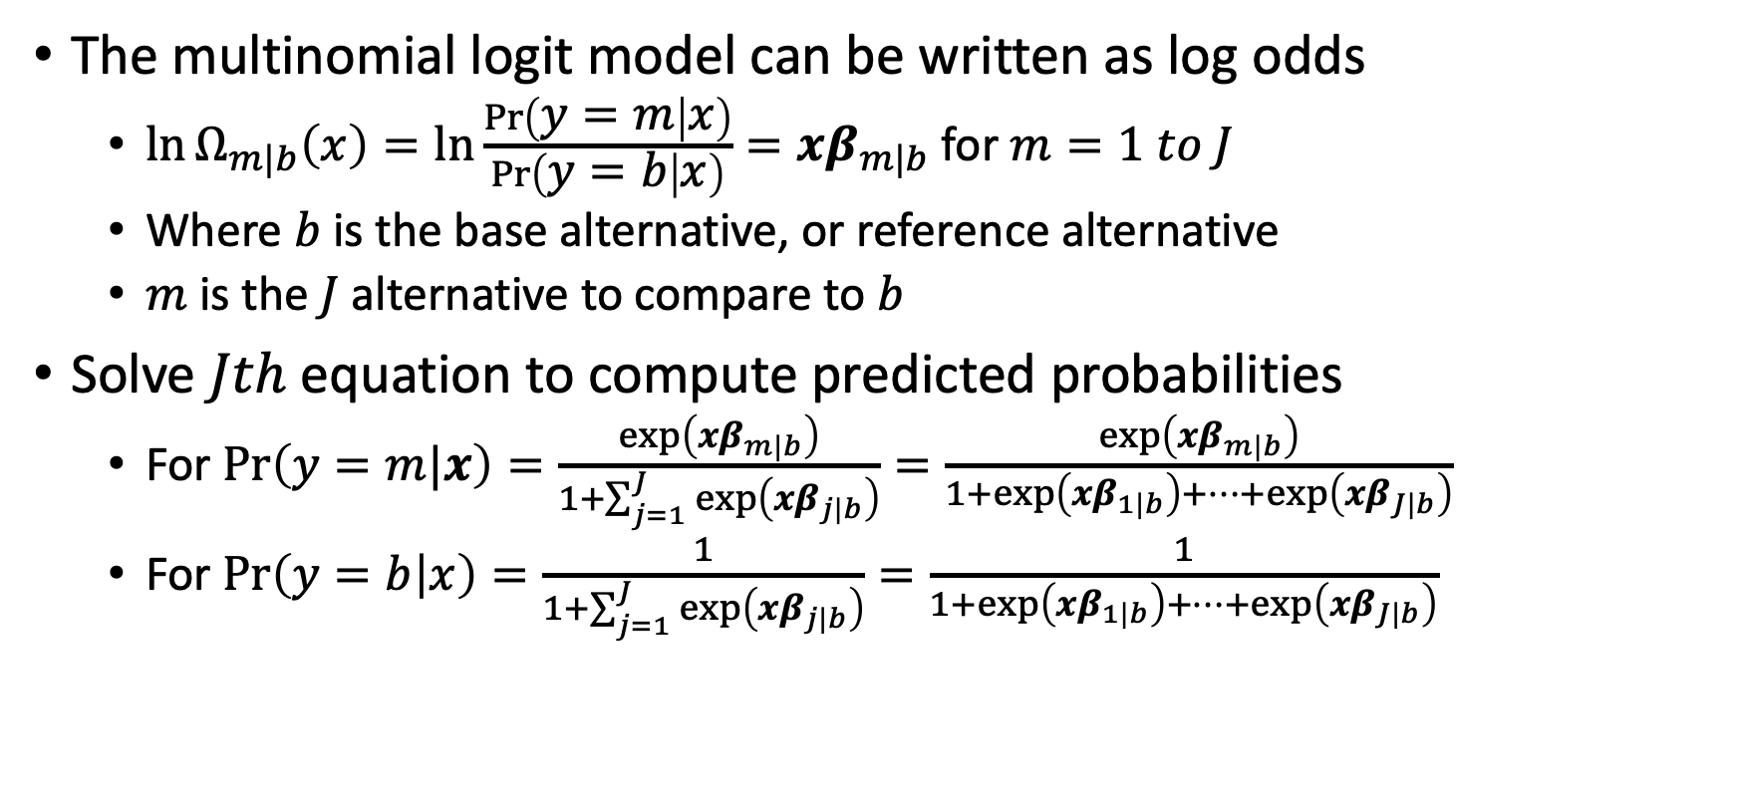
Multinomial Logit Model
The multinomial logit model can be written as log odds
$\ln{Ω_{m|b}\left(x\right)=\ln{\frac{\operatorname{Pr}\left(y=m | x\right)}{\operatorname{Pr}\left(y=b | x\right)}=xβ_{m|b}}}$ for $m=1 to J$
Where $b$ is the base alternative, or reference alternative
$m$ is the $J$ alternative to compare to $b$
Solve $Jth$ equation to compute predicted probabilities
For $\operatorname{Pr}\left(y=m|x\right)=\frac{\exp\left(xβ_{m|b}\right)}{1+\sum_{j=1}^{J}{\exp\left(xβ_{j|b}\right)}}=\frac{\exp\left(xβ_{m|b}\right)}{1+exp\left(xβ_{1|b}\right)+…+\exp\left(xβ_{J|b}\right)}$
For $\operatorname{Pr}\left(y=b | x\right)=\frac{1}{1+\sum_{j=1}^{J}{\exp\left(xβ_{j|b}\right)}}=\frac{1}{1+exp\left(xβ_{1|b}\right)+…+\exp\left(xβ_{J|b}\right)}$

Slide 43
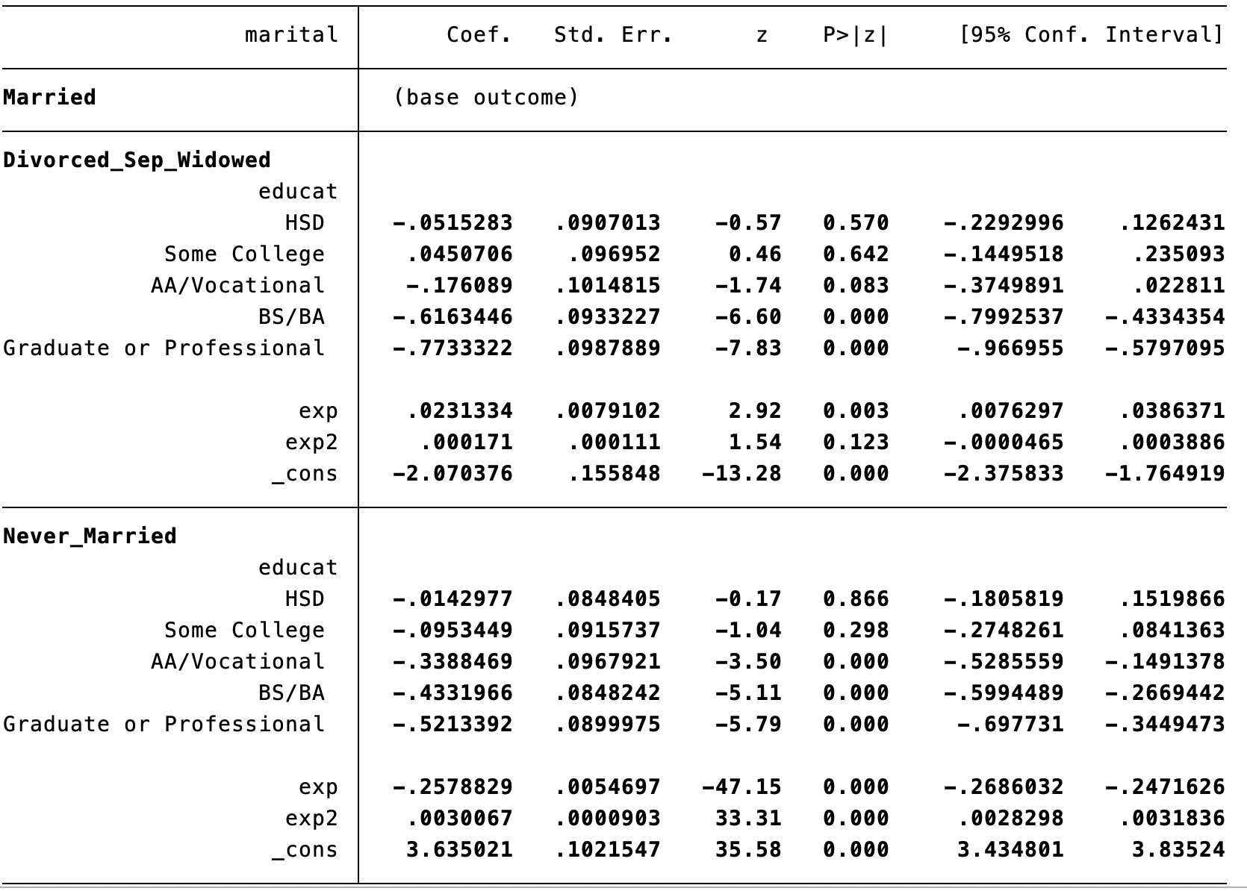
Multinomial Logit Model

Slide 44
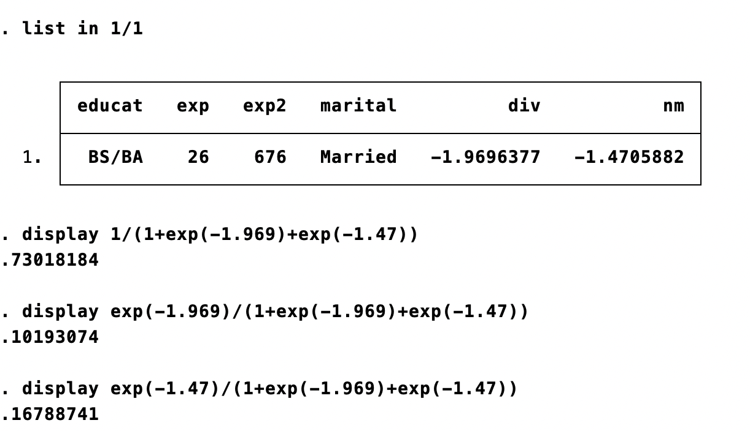
Multinomial Logit Model
Estimate the predicted probabilities for each outcome
Reference/Base
Divorced/Separated/Widowed
Never married

Slide 45
Independence of Irrelevant Alternatives
We have a key assumption with multinomial logit models
Independence of irrelevant alternatives (IIA)
Adding or deleting the alternatives does not affect the odds among the remaining alternatives
For example, we have a red bus and car for transportation
Suppose the odds of taking a red bus relative to the car is 1:1
However, an identical bus comes to town as another alternative but it is blue
The IIA implies that the odds will remain 1:1 between red bus and car even if the blue bus is identical to the red bus except for the color
We would expect the odds of riding the red bus to fall relative to the car, since half of the bus riders take the red bus and the other half take the blue bus
The probability of riding a care can be small by adding enough color buses

Slide 46
Independence of Irrelevant Alternatives
Hausman-McFadden Test of IIA
We will compare the estimated coefficients from the full model to those of a restricted model where one alternative (blue bus) is removed
If the test static is significant, then a multinomial logit is inappropriate
We can use the Hausman command in Stata
Williams (2022) tells us to consider combining alternative/categories, especially if the categories are small

Slide 47
Interpretation
Marginal Changes
Marginal effects are more straightforward to interpret and usually preferred in economic literature
We want to know what the change in response probability with a change in x similar to binary response relative to the base
We still need to be concerned about the scale factor
Marginal Effects
Marginal effects at the average (MEA)
Average marginal effects (AME)

Slide 48
Nonnegative Dependent Variables

Slide 49
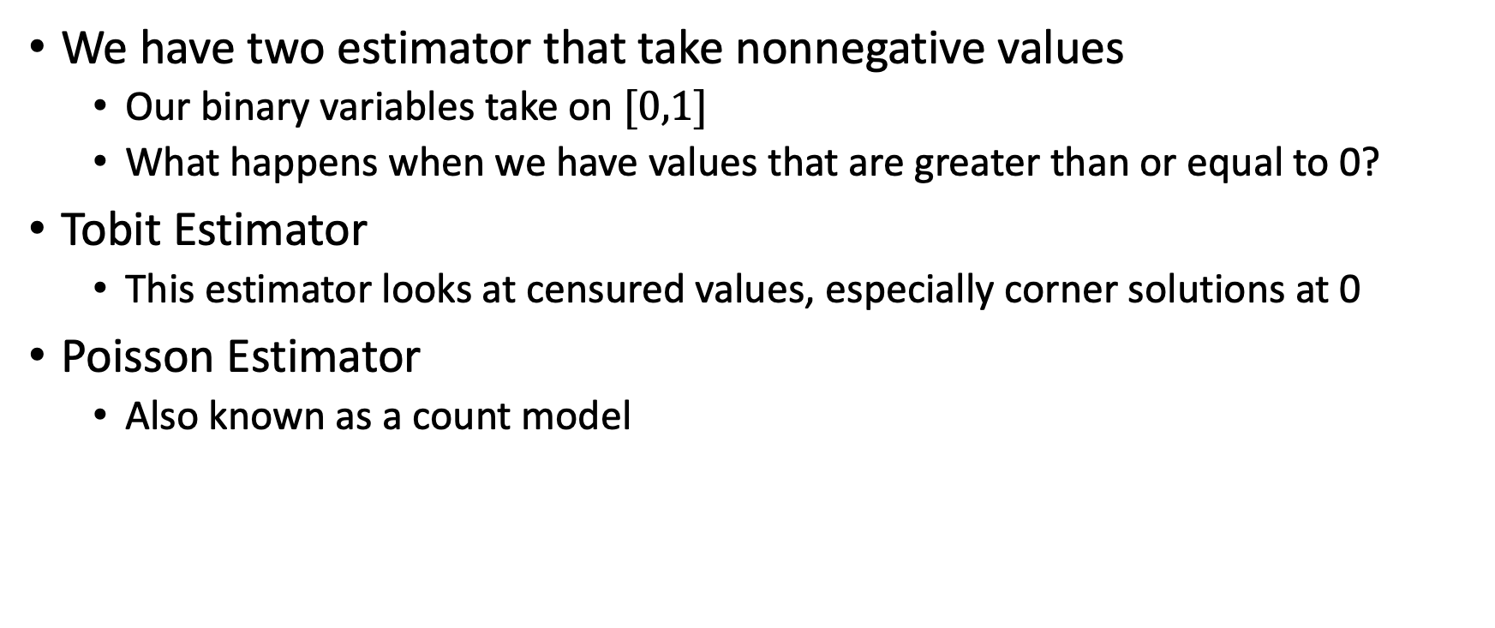
Nonnegative Dependent Variables
We have two estimator that take nonnegative values
Our binary variables take on $[0,1]$
What happens when we have values that are greater than or equal to 0?
Tobit Estimator
This estimator looks at censured values, especially corner solutions at 0
Poisson Estimator
Also known as a count model

Slide 50
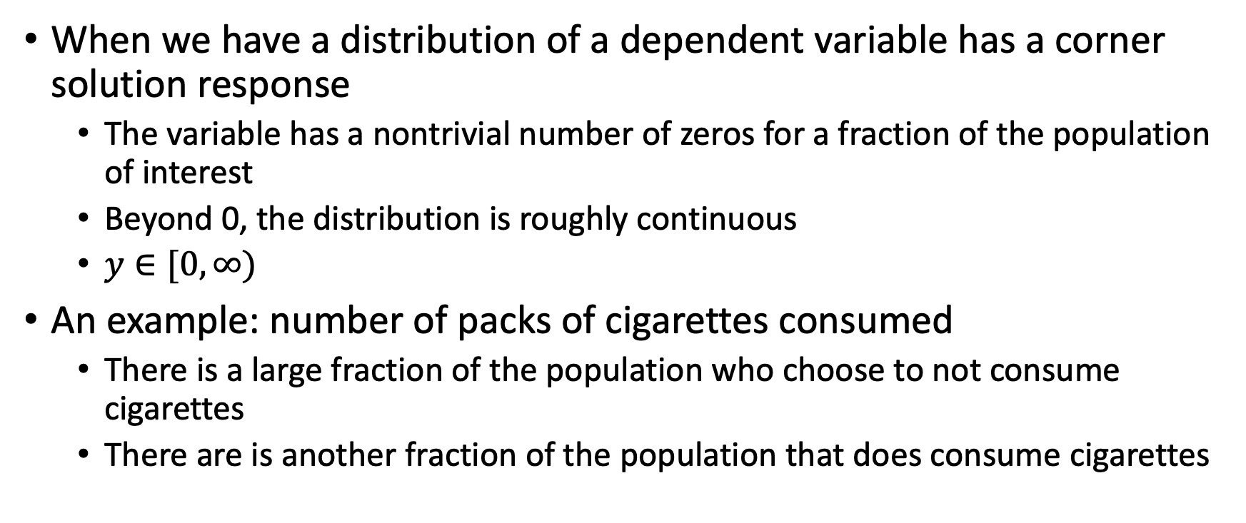
Tobit
When we have a distribution of a dependent variable has a corner solution response
The variable has a nontrivial number of zeros for a fraction of the population of interest
Beyond 0, the distribution is roughly continuous
$y∈[0,∞)$
An example: number of packs of cigarettes consumed
There is a large fraction of the population who choose to not consume cigarettes
There are is another fraction of the population that does consume cigarettes

Slide 51
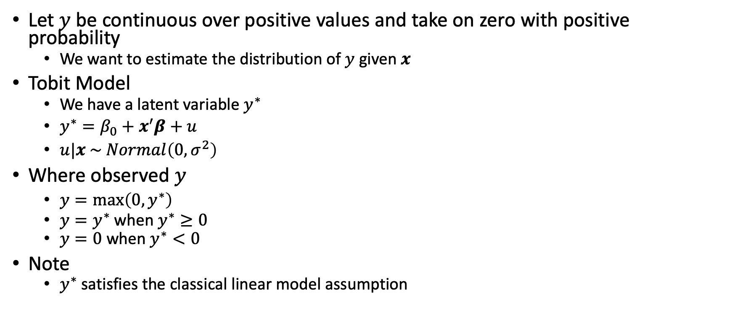
Tobit
Let $y$ be continuous over positive values and take on zero with positive probability
We want to estimate the distribution of $y$ given $x$
Tobit Model
We have a latent variable $y^{∗}$
$y^{∗}=β_{0}+x^{′}β+u$
$u|x \sim Normal\left(0,σ^{2}\right)$
Where observed $y$
$y=\max\left(0,y^{∗}\right)$
$y=y^{∗}$ when $y^{∗}≥0$
$y=0$ when $y^{∗}<0$
Note
$y^{∗}$ satisfies the classical linear model assumption

Slide 52
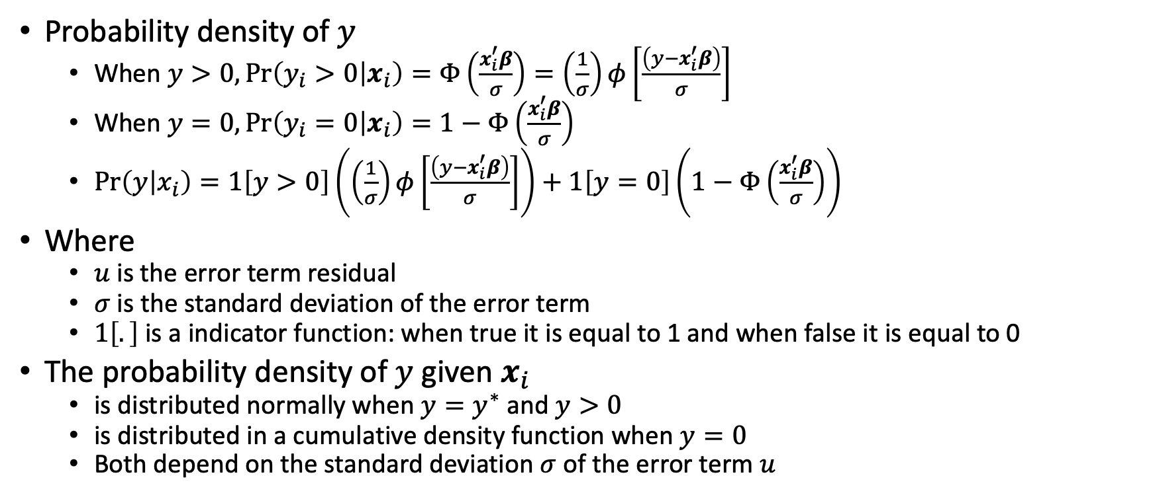
Tobit
Probability density of $y$
When $y>0,\operatorname{Pr}\left(y_{i}>0 | x_{i}\right)=Φ\left(\frac{x_{i}^{′}β}{σ}\right)=\left(\frac{1}{σ}\right)φ\left[\frac{\left(y−x_{i}^{′}β\right)}{σ}\right]$
When $y=0,\operatorname{Pr}\left(y_{i}=0 | x_{i}\right)=1−Φ\left(\frac{x_{i}^{′}β}{σ}\right)$
$\operatorname{Pr}\left(y | x_{i}\right)=1\left[y>0\right]\left(\left(\frac{1}{σ}\right)φ\left[\frac{\left(y−x_{i}^{′}β\right)}{σ}\right]\right)+1\left[y=0\right]\left(1−Φ\left(\frac{x_{i}^{′}β}{σ}\right)\right)$
Where
$u$ is the error term residual
$σ$ is the standard deviation of the error term
$1\left[.\right]$ is a indicator function: when true it is equal to 1 and when false it is equal to 0
The probability density of $y$ given $x_{i}$
is distributed normally when $y=y^{∗}$ and $y>0$
is distributed in a cumulative density function when $y=0$
Both depend on the standard deviation $σ$ of the error term $u$

Slide 53
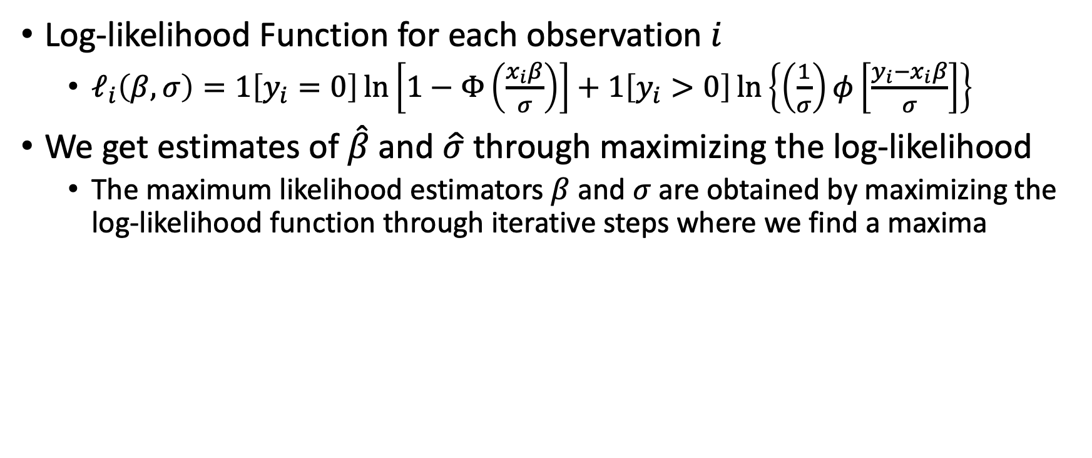
Tobit
Log-likelihood Function for each observation $i$
$ℓ_{i}\left(β,σ\right)=1\left[y_{i}=0\right]\ln\left[1−Φ\left(\frac{x_{i}β}{σ}\right)\right]+1\left[y_{i}>0\right]\ln\left\{\left(\frac{1}{σ}\right)φ\left[\frac{y_{i}−x_{i}β}{σ}\right]\right\}$
We get estimates of $\hat{β}$and $\hat{σ}$ through maximizing the log-likelihood
The maximum likelihood estimators $β$ and $σ$are obtained by maximizing the log-likelihood function through iterative steps where we find a maxima

Slide 54
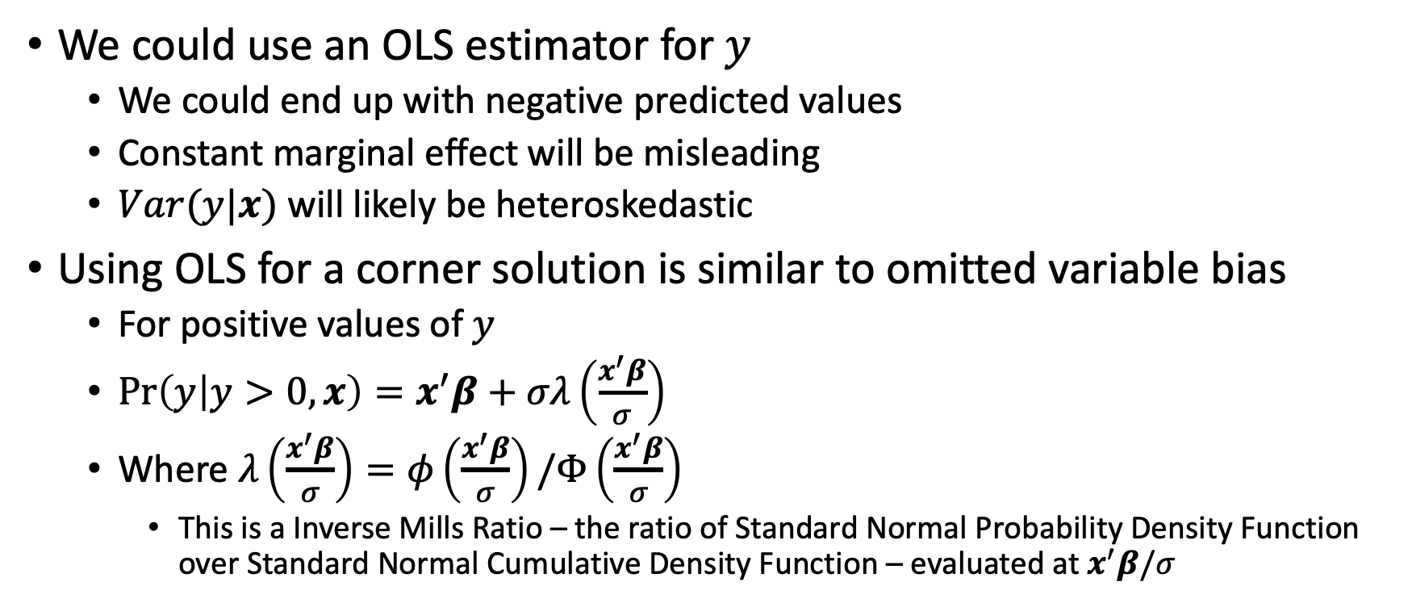
Tobit
We could use an OLS estimator for $y$
We could end up with negative predicted values
Constant marginal effect will be misleading
$Var(y|x)$ will likely be heteroskedastic
Using OLS for a corner solution is similar to omitted variable bias
For positive values of $y$
$\operatorname{Pr}\left(y | y>0,x\right)=x^{′}β+σλ\left(\frac{x^{′}β}{σ}\right)$
Where $λ\left(\frac{x^{′}β}{σ}\right)=φ\left(\frac{x^{′}β}{σ}\right)/Φ\left(\frac{x^{′}β}{σ}\right)$
This is a Inverse Mills Ratio – the ratio of Standard Normal Probability Density Function over Standard Normal Cumulative Density Function – evaluated at $x^{′}β/σ$

Slide 58
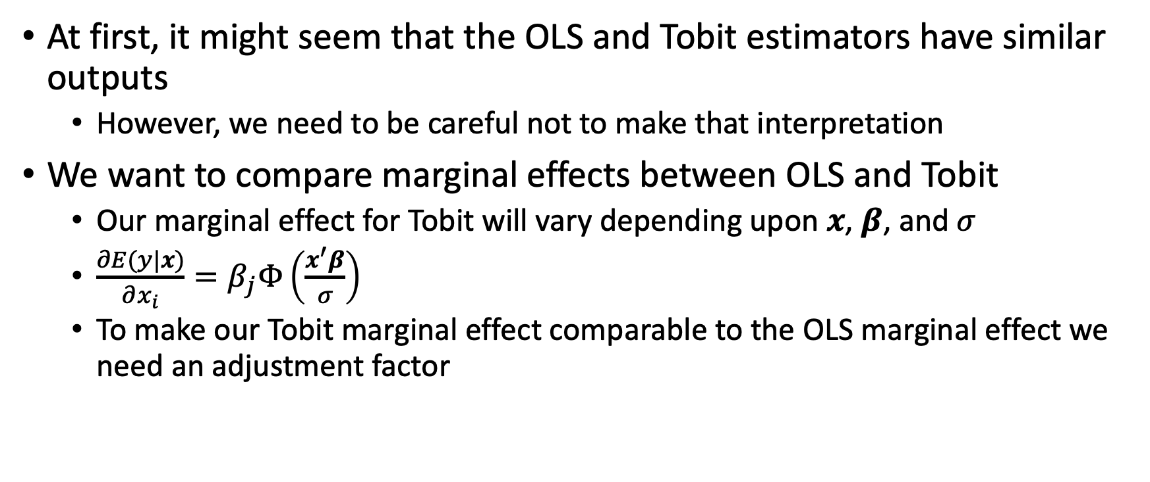
Interpreting Tobit
At first, it might seem that the OLS and Tobit estimators have similar outputs
However, we need to be careful not to make that interpretation
We want to compare marginal effects between OLS and Tobit
Our marginal effect for Tobit will vary depending upon $x$, $β$, and $σ$
$\frac{∂E(y|x)}{∂x_{i}}=β_{j}Φ\left(\frac{x^{′}β}{σ}\right)$
To make our Tobit marginal effect comparable to the OLS marginal effect we need an adjustment factor

Slide 59
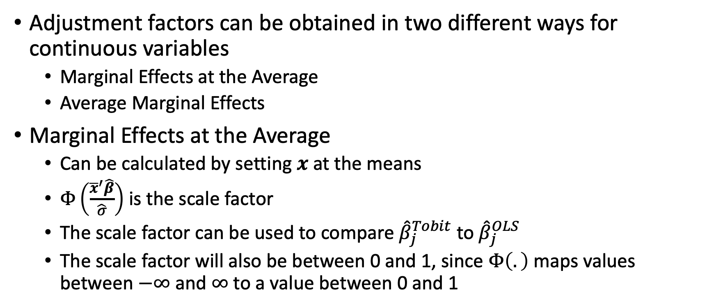
Interpreting Tobit
Adjustment factors can be obtained in two different ways for continuous variables
Marginal Effects at the Average
Average Marginal Effects
Marginal Effects at the Average
Can be calculated by setting $x$ at the means
$Φ\left(\frac{{\overline{x}}^{′}\hat{β}}{\hat{σ}}\right)$ is the scale factor
The scale factor can be used to compare ${\hat{β}}_{j}^{Tobit}$ to ${\hat{β}}_{j}^{OLS}$
The scale factor will also be between 0 and 1, since $Φ\left(.\right)$ maps values between $−∞$ and $∞$ to a value between 0 and 1

Slide 60
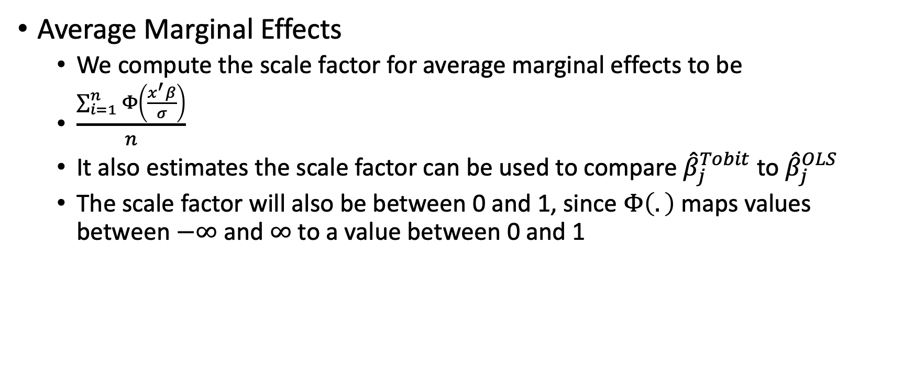
Interpreting Tobit
Average Marginal Effects
We compute the scale factor for average marginal effects to be
$\frac{\sum_{i=1}^{n}{Φ\left(\frac{x^{′}β}{σ}\right)}}{n}$
It also estimates the scale factor can be used to compare ${\hat{β}}_{j}^{Tobit}$ to ${\hat{β}}_{j}^{OLS}$
The scale factor will also be between 0 and 1, since $Φ\left(.\right)$ maps values between $−∞$ and $∞$ to a value between 0 and 1

Slide 61
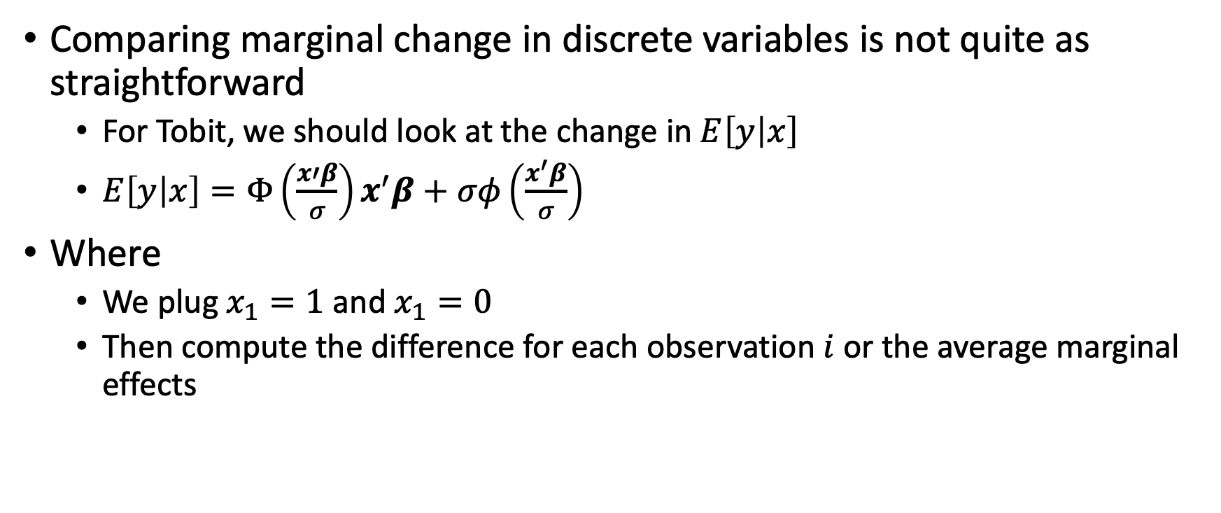
Interpreting Tobit
Comparing marginal change in discrete variables is not quite as straightforward
For Tobit, we should look at the change in $E\left[y | x\right]$
$E\left[y | x\right]=Φ\left(\frac{x′β}{σ}\right)x^{′}β+σφ\left(\frac{x^{′}β}{σ}\right)$
Where
We plug $x_{1}=1$ and $x_{1}=0$
Then compute the difference for each observation $i$ or the average marginal effects

Slide 62
Next Week
Nonnegative
Poisson
Negative Binomial
Other Limited Dependent
Censored
Truncated
Sample Selection

Slide 63
Stata

